Slide 1
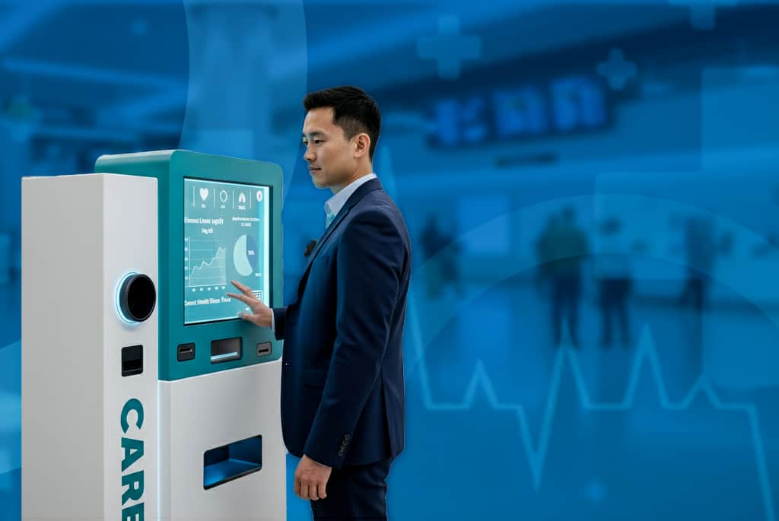

Slide 3

Contents :
GET TO KNOW US
TIMELINE
PROBLEM
HOW TO USE
SOLUTION
BRAND IDENTITY
TARGET PERSONAS
MARKETING
DEVICE FUNCTIONS
COMMON Q&A

Slide 4
Contents :
GET TO KNOW US
TIMELINE
PROBLEM
HOW TO USE
SOLUTION
BRAND IDENTITY
TARGET PERSONAS
MARKETING
DEVICE FUNCTIONS
COMMON Q&A

Slide 5
Contents :
GET TO KNOW US
TIMELINE
PROBLEM
HOW TO USE
SOLUTION
BRAND IDENTITY
TARGET PERSONAS
MARKETING
DEVICE FUNCTIONS
COMMON Q&A

Slide 6
Contents :
GET TO KNOW US
TIMELINE
PROBLEM
HOW TO USE
SOLUTION
BRAND IDENTITY
TARGET PERSONAS
MARKETING
DEVICE FUNCTIONS
COMMON Q&A

Slide 7
Contents :
GET TO KNOW US
TIMELINE
PROBLEM
HOW TO USE
SOLUTION
BRAND IDENTITY
TARGET PERSONAS
MARKETING
DEVICE FUNCTIONS
COMMON Q&A

Slide 8
Contents :
GET TO KNOW US
TIMELINE
PROBLEM
HOW TO USE
SOLUTION
BRAND IDENTITY
TARGET PERSONAS
MARKETING
DEVICE FUNCTIONS
COMMON Q&A

Slide 9
Contents :
GET TO KNOW US
TIMELINE
PROBLEM
HOW TO USE
SOLUTION
BRAND IDENTITY
TARGET PERSONAS
MARKETING
DEVICE FUNCTIONS
COMMON Q&A

Slide 10
Contents :
GET TO KNOW US
TIMELINE
PROBLEM
HOW TO USE
SOLUTION
BRAND IDENTITY
TARGET PERSONAS
MARKETING
DEVICE FUNCTIONS
COMMON Q&A

Slide 11
Contents :
GET TO KNOW US
TIMELINE
PROBLEM
HOW TO USE
SOLUTION
BRAND IDENTITY
TARGET PERSONAS
MARKETING
DEVICE FUNCTIONS
COMMON Q&A

Slide 12
Contents :
GET TO KNOW US
TIMELINE
PROBLEM
HOW TO USE
SOLUTION
BRAND IDENTITY
TARGET PERSONAS
MARKETING
DEVICE FUNCTIONS
COMMON Q&A

Slide 13
Contents :
GET TO KNOW US
TIMELINE
PROBLEM
HOW TO USE
SOLUTION
BRAND IDENTITY
TARGET PERSONAS
MARKETING
DEVICE FUNCTIONS
COMMON Q&A

Slide 14





MEET THE INNOVATORS : TAMMEN TEAM MEET THE INNOVATORS : TAMMEN TEAM MEET THE INNOVATORS : TAMMEN TEAM MEET THE INNOVATORS : TAMMEN MEET THE INNOVATORS : TAMMEN TEAM MEET THE INNOVATORS : TAMMEN TEAM
GET TO KNOW US
WHO ARE WE ?

Slide 15
MEET THE INNOVATORS : TAMMEN TEAM MEET THE INNOVATORS : TAMMEN TEAM MEET THE INNOVATORS : TAMMEN TEAM MEET THE INNOVATORS : TAMMEN MEET THE INNOVATORS : TAMMEN TEAM MEET THE INNOVATORS : TAMMEN TEAM
TEAM
GET TO KNOW US
WHO ARE WE ?
MOHAMMED HANY ELBOKHARY
TEAM LEADER
FACULTY OF MEDICINE- BENHA UNIVERSITY
ROLE : matching the identity of the project’s file

Slide 16
MEET THE INNOVATORS : TAMMEN TEAM MEET THE INNOVATORS : TAMMEN TEAM MEET THE INNOVATORS : TAMMEN TEAM MEET THE INNOVATORS : TAMMEN MEET THE INNOVATORS : TAMMEN TEAM MEET THE INNOVATORS : TAMMEN TEAM
TEAM
GET TO KNOW US
WHO ARE WE ?
SAMIR SAMEH SAMIR
TEAM MEMBER
FACULTY OF BIS ELMOKATTEM HIGHER INSTITUTE
ROLE : UI & UX of the device and making the final prototype with AI

Slide 17
MEET THE INNOVATORS : TAMMEN TEAM MEET THE INNOVATORS : TAMMEN TEAM MEET THE INNOVATORS : TAMMEN TEAM MEET THE INNOVATORS : TAMMEN MEET THE INNOVATORS : TAMMEN TEAM MEET THE INNOVATORS : TAMMEN TEAM
TEAM
GET TO KNOW US
WHO ARE WE ?
SHOROUK OSMAN HASSANY
TEAM MEMBER
FACULTY OF APPLIED ARTS HELWAN UNIVERSITY
ROLE : PRESENTATION , SOCIAL MEDIA ADS and BROCHURE designs

Slide 18
MEET THE INNOVATORS : TAMMEN TEAM MEET THE INNOVATORS : TAMMEN TEAM MEET THE INNOVATORS : TAMMEN TEAM MEET THE INNOVATORS : TAMMEN MEET THE INNOVATORS : TAMMEN TEAM MEET THE INNOVATORS : TAMMEN TEAM
TEAM
GET TO KNOW US
WHO ARE WE ?
ALSHIMAA ANWAR ALI
TEAM MEMBER
FACULTY OF APPLIED ARTS HELWAN UNIVERSITY
ROLE : WEBSITE & MOODBOARD designs

Slide 19
MEET THE INNOVATORS : TAMMEN TEAM MEET THE INNOVATORS : TAMMEN TEAM MEET THE INNOVATORS : TAMMEN TEAM MEET THE INNOVATORS : TAMMEN MEET THE INNOVATORS : TAMMEN TEAM MEET THE INNOVATORS : TAMMEN TEAM
GET TO KNOW US
WHO ARE WE ?
AHMED HUSSIEN ABDELKARIM
TEAM MEMBER
FACULTY OF BIS ELMOKATTEM HIGHER INSTITUTE
ROLE : BUSINESS CARD & MAGAZINE designs

Slide 20
PROBLEM
Many people experience high or low blood pressure and unstable blood sugar levels but do not check them regularly.
Even though measuring these levels does not require appointments or medical staff, most individuals still avoid doing it because they don’t have easy access to a simple, public, and fast solution. When people do check their readings, they often struggle to understand whether the result is high, low, or normal and they usually don’t know what immediate action to take. Existing devices can also be confusing or not user friendly for children, elderly individuals, and people with no medical knowledge.

Slide 21
SOLUTION
A fully automated public health check-up machine that makes health monitoring simple, fast, and accessible to everyone. The device accurately measures blood pressure and blood sugar, then provides an instant response by dispensing salty water, sugary water, or natural juice based on the user’s condition. With a very simple UI designed for all ages, it offers reliable health insights and immediate corrective support anytime, anywhere.

Slide 22
TARGET PARSONAS
The CARE system is designed to serve all members of society, with particular
emphasis on individuals at higher risk due to limited access to health services or
chronic health needs, including:
• People living with hypertension, diabetes, and cardiovascular diseases
• Residents of remote or underserved areas where medical centers are scarce
• Individuals who lack regular medical follow-up or health education resources

Slide 23
TARGET PARSONAS
The CARE system is designed to serve all members of society, with particular
emphasis on individuals at higher risk due to limited access to health services or
chronic health needs, including:
• People living with hypertension, diabetes, and cardiovascular diseases
• Residents of remote or underserved areas where medical centers are scarce
• Individuals who lack regular medical follow-up or health education resources
Notes:
<svg id="Layer_1" data-name="Layer 1" xmlns="http://www.w3.org/2000/svg" viewBox="0 0 223.96 256"><defs><style>.cls-1{fill:#fff;}</style></defs><path class="cls-1" d="M263,549.89h-7c-11.1-6-13-11-8.68-23.21A241.46,241.46,0,0,0,255.51,499c1.76-7.81,3.1-15.7,2.4-23.76-.55-6.32-2.61-9.14-7.75-10.15a60.89,60.89,0,0,0-23.34,0,8.39,8.39,0,0,0-7.22,7.26,47.38,47.38,0,0,0-.1,15.4c1.82,13.42,5.73,26.3,10.22,39,4.3,12.18,2.37,17.22-8.72,23.19h-7c-6.27-3-9.41-8.16-11.51-14.63-5.76-17.77-11.42-35.52-11.91-54.42-.26-10,1.25-19.56,6.78-28.2,1.41-2.2,2.39-2.51,4.42-.58a82.77,82.77,0,0,0,9,7.17c6.1,4.33,12.59,3.65,16.35-1.52s2.47-11.65-3.44-16a76.56,76.56,0,0,1-10.59-9.11c-2.83-3-4.55-6.29-4.18-10.72.4-4.67.09-9.41.09-15-5.54,7.49-5.68,15.23-1,22.58,3.75,5.87,9.12,10.07,14.62,14.17,4.75,3.54,5.77,8.44,2.87,12.57-3.06,4.36-8.11,5-13.19,1.5-7.05-4.85-13.44-10.42-18.26-17.58-8.46-12.57-9.32-25.7-2.47-39.23,3.58-7.08,8.8-12.86,14.68-18.14a18.64,18.64,0,0,1,13.22-4.82c12.66,0,25.33.12,38,0a12.58,12.58,0,0,1,11.63,6.31,38.82,38.82,0,0,0,9.2,10.22c1.23-1.18.79-2.41.92-3.49C280.28,382,281.4,373.06,286,365c1.08-1.89,2.39-3.42,2.38-6.15,0-2.45,2.52-5.74,5.68-5,6.78,1.69,12.87,5,15.27,12.19,2,6,6.29,9.16,11.69,11.37,3.13,1.29,5.12.85,6.09-3.07a170.14,170.14,0,0,0,5-34,10.46,10.46,0,0,0-2.25-7.29,24.44,24.44,0,0,1,5.75-34.83c2.91-2,6.39-2.65,9.39-4.38h9c1.67.67,3.34,1.33,5,2a24.65,24.65,0,0,1,14.87,26.25c-1.56,10.79-10.67,19.65-21.33,20.76-5.94.61-6.1.84-5.12,7.31,8.29-6.63,26.76-4.66,34.41,2.69a66.14,66.14,0,0,1,15.77,24c13,33.32,15.1,68,12.16,103.21-.27,3.23-2.47,4.54-5,5.55a60.91,60.91,0,0,1-18.51,3.86c-3.94.27-4.44,1.9-4.52,5.22-.33,13.49-.94,27-1.4,40.46-.16,4.6-1.79,8.48-5.58,11.18A13.64,13.64,0,0,1,353.08,535c.29-13.16.64-26.32,1.25-39.46.18-3.81-.43-5.45-4.79-5.93-11.58-1.28-13.28-3.49-13.83-15.27a209.87,209.87,0,0,1,.81-25.45c.52-7,1-14,1.56-22-3.28,2.17-6,2.08-8.64,1.93-5.64-.32-11.3-.62-16.92-1.26-2.48-.28-3.32,0-2.92,2.73a31.93,31.93,0,0,1-.05,10.46c-.86,4.72-2.08,9.39-7.64,10.55s-9.26-1.82-12.39-5.79c-3.9-4.94-5.94-10.79-7.32-16.8-.72-3.13-1.61-5.63-5-6.66-1.87-.56-3.65-2.14-3.07-4,1.76-5.63-2.51-6.33-6.09-8.48,0,10.24,0,19.9,0,29.55,0,1.37,0,2.62,1.35,3.5,15.28,10.22,17.83,25.56,16.84,42.25-1,17.46-6.39,33.91-11.7,50.4C272.45,541.75,269.32,547,263,549.89Zm37.94-147.52c-4.46.48-7.92-2-11.56-3.62-3.25-1.46-4.86-.71-6.13,2.43q-2.79,6.94-6.06,13.68c-1.36,2.8-1.08,4.56,2,5.86q10.8,4.54,21.45,9.46c2.72,1.25,4.72.91,5.35-2.06,1.42-6.63,5.65-8.08,11.64-7a21,21,0,0,0,4.48-.05c30.51-1.21,51.21-22.43,51.72-53,.08-4.22-.92-8-4.43-10.6a10.24,10.24,0,0,0-11.29-1.15c-4.1,2-6,5.48-6.17,10.07-.28,9.22-2.37,17.83-9.15,24.64-1.15,1.15-2.83,3-3.93,2.77-4.39-.87-7.33,1-10.13,3.91a4.83,4.83,0,0,1-5.15.92c-1-.33,1.06-1.71-.23-2.42-.24.24-.57.42-.71.71a3.68,3.68,0,0,1-4.44,2.32c-3.07-.73-.31-2.22-.31-3.35,0-1.41-1.24-1.44-2-1.71-8.13-2.76-14.34-8.2-20.36-14-4.6-4.46-6.82-9.15-3.51-15.74-1,.29-1,1-1.4,1.59-5.37,8.49-6.3,18.09-7.08,27.74-.16,2,1,1.8,2.46,2C291.55,396.55,296.11,399.76,300.94,402.37Zm-14.63,24.34a41.86,41.86,0,0,0,5.78,14.92c2.07,3.11,4.63,6.2,8.82,5.23s4-5.16,4.39-8.54c.18-1.71,1-4.6-.92-4.91C298.05,432.4,293,428.17,286.31,426.71ZM331.5,375.3a4.89,4.89,0,0,0,3.85-2.71c5.7-8.83,6.13-19.09,7.47-29,.35-2.59-3.19-2.32-5-3.16-1.32-.63-1.41,1-1.45,1.9A178.19,178.19,0,0,1,331.5,375.3Zm37.38,68.75c-5,1.25-10,2.56-15,3.72-1.72.4-1.54,1.29-1.16,2.54s.54,2.38,2.24,1.81l14.62-4.84a1.64,1.64,0,0,0,1.24-2.27C370.54,444,369.75,443.94,368.88,444.05Z" transform="translate(-186.98 -293.89)"/><path class="cls-1" d="M248.53,373.11a25.61,25.61,0,1,1-.1-51.22,25.61,25.61,0,0,1,.1,51.22Z" transform="translate(-186.98 -293.89)"/><path class="cls-1" d="M253.64,496.89a9,9,0,0,1-.51-1.08c-.61-3.76,1.1-8.76-1.49-11.05S244,484.15,240,484c-3.66-.14-7.35.21-11-.1s-4.78,1-4.71,4.4a42.09,42.09,0,0,1-.74,7.95,61.58,61.58,0,0,1-2.49-19.51c.1-2.63,1-3.83,3.9-3.78q13.49.23,27,0c2.85,0,3.81,1.1,3.92,3.76C256.18,483.39,255.13,489.87,253.64,496.89Z" transform="translate(-186.98 -293.89)"/><path class="cls-1" d="M254.14,469.49H224C228.8,465.29,245.94,465,254.14,469.49Z" transform="translate(-186.98 -293.89)"/><path class="cls-1" d="M238.84,520.33c1.64,0,3.3-.11,4.93,0,1.1.1,3.06-.67,2.81,1.51-.15,1.3-.34,3.11-2.46,3.1-3.78,0-7.57,0-11.35,0-2.11,0-2.18-1.92-2.34-3.2-.23-1.78,1.47-1.33,2.49-1.38C234.89,520.27,236.86,520.34,238.84,520.33Z" transform="translate(-186.98 -293.89)"/><path class="cls-1" d="M316.78,419a80.41,80.41,0,0,1-8.1-.47c-5.41-.79-8.45-4.64-8-9.65.48-4.85,4.41-8.13,9.83-7.74a73.05,73.05,0,0,0,13.95,0c17.82-2.17,28.33-13.31,29.48-31.41.06-1,0-2,.09-3,.35-5.8,3.79-9.36,9-9.27,4.89.09,8.64,3.72,8.53,9.17-.26,14.24-4.08,27.29-14.32,37.77C346.39,415.57,332.64,419,316.78,419Z" transform="translate(-186.98 -293.89)"/></svg><svg id="Layer_1" data-name="Layer 1" xmlns="http://www.w3.org/2000/svg" viewBox="0 0 223.96 256"><defs><style>.cls-1{fill:#fff;}</style></defs><path class="cls-1" d="M-269,263.89h-7c-11.1-6-13-11-8.68-23.21A241.46,241.46,0,0,0-276.49,213c1.76-7.81,3.1-15.7,2.4-23.76-.55-6.32-2.61-9.14-7.75-10.15a60.89,60.89,0,0,0-23.34,0,8.39,8.39,0,0,0-7.22,7.26,47.38,47.38,0,0,0-.1,15.4c1.82,13.42,5.73,26.3,10.22,39,4.3,12.18,2.37,17.22-8.72,23.19h-7c-6.27-3-9.41-8.16-11.51-14.63-5.76-17.77-11.42-35.52-11.91-54.42-.26-10,1.25-19.56,6.78-28.2,1.41-2.2,2.39-2.51,4.42-.58a82.77,82.77,0,0,0,9,7.17c6.1,4.33,12.59,3.65,16.35-1.52s2.47-11.65-3.44-16.05a76.56,76.56,0,0,1-10.59-9.11c-2.83-3-4.55-6.29-4.18-10.72.4-4.67.09-9.41.09-15-5.54,7.49-5.68,15.23-1,22.58,3.75,5.87,9.12,10.07,14.62,14.17,4.75,3.54,5.77,8.44,2.87,12.57-3.06,4.36-8.11,5-13.19,1.5-7-4.85-13.44-10.42-18.26-17.58-8.46-12.57-9.32-25.7-2.47-39.23,3.58-7.08,8.8-12.86,14.68-18.14a18.64,18.64,0,0,1,13.22-4.82c12.66,0,25.33.12,38,0a12.58,12.58,0,0,1,11.63,6.31,38.82,38.82,0,0,0,9.2,10.22c1.23-1.18.79-2.41.92-3.49C-251.72,96-250.6,87.06-246,79c1.08-1.89,2.39-3.42,2.38-6.15,0-2.45,2.52-5.74,5.68-5,6.78,1.69,12.87,5,15.27,12.19,2,6,6.29,9.16,11.69,11.37,3.13,1.29,5.12.85,6.09-3.07a170.14,170.14,0,0,0,5-34,10.46,10.46,0,0,0-2.25-7.29,24.44,24.44,0,0,1,5.75-34.83c2.91-2,6.39-2.65,9.39-4.38h9c1.67.67,3.34,1.33,5,2a24.65,24.65,0,0,1,14.87,26.25C-159.69,47-168.8,55.82-179.46,56.93c-5.94.61-6.1.84-5.12,7.31,8.29-6.63,26.76-4.66,34.41,2.69a66.14,66.14,0,0,1,15.77,24c13,33.32,15.1,68,12.16,103.21-.27,3.23-2.47,4.54-5,5.55a60.91,60.91,0,0,1-18.51,3.86c-3.94.27-4.44,1.9-4.52,5.22-.33,13.49-.94,27-1.4,40.46-.16,4.6-1.79,8.48-5.58,11.18a13,13,0,0,1-14.16,1.15,13,13,0,0,1-7.5-12.58c.29-13.16.64-26.32,1.25-39.46.18-3.81-.43-5.45-4.79-5.93-11.58-1.28-13.28-3.49-13.83-15.27a209.87,209.87,0,0,1,.81-25.45c.52-7,1-14,1.56-22-3.28,2.17-6,2.08-8.64,1.93-5.64-.32-11.3-.62-16.92-1.26-2.48-.28-3.32,0-2.92,2.73a31.93,31.93,0,0,1,0,10.46c-.86,4.72-2.08,9.39-7.64,10.55s-9.26-1.82-12.39-5.79c-3.9-4.94-5.94-10.79-7.32-16.8-.72-3.13-1.61-5.63-5-6.66-1.87-.56-3.65-2.14-3.07-4,1.76-5.63-2.51-6.33-6.09-8.48,0,10.24,0,19.9,0,29.55,0,1.37,0,2.62,1.35,3.5,15.28,10.22,17.83,25.56,16.84,42.25-1,17.46-6.39,33.91-11.7,50.4C-259.55,255.75-262.68,261-269,263.89Zm37.94-147.52c-4.46.48-7.92-2-11.56-3.62-3.25-1.46-4.86-.71-6.13,2.43q-2.79,6.94-6.06,13.68c-1.36,2.8-1.08,4.56,2,5.86q10.8,4.54,21.45,9.46c2.72,1.25,4.72.91,5.35-2.06,1.42-6.63,5.65-8.08,11.64-7a21,21,0,0,0,4.48-.05c30.51-1.21,51.21-22.43,51.72-53,.08-4.22-.92-7.95-4.43-10.6a10.24,10.24,0,0,0-11.29-1.15c-4.1,2-6,5.48-6.17,10.07-.28,9.22-2.37,17.83-9.15,24.64-1.15,1.15-2.83,3-3.93,2.77-4.39-.87-7.33,1-10.13,3.91a4.83,4.83,0,0,1-5.15.92c-1-.33,1.06-1.71-.23-2.42-.24.24-.57.42-.71.71a3.68,3.68,0,0,1-4.44,2.32c-3.07-.73-.31-2.22-.31-3.35,0-1.41-1.24-1.44-2.05-1.71-8.13-2.76-14.34-8.2-20.36-14-4.6-4.46-6.82-9.15-3.51-15.74-.95.29-1,1-1.4,1.59-5.37,8.49-6.3,18.09-7.08,27.74-.16,2,1,1.8,2.46,2C-240.45,110.55-235.89,113.76-231.06,116.37Zm-14.63,24.34a41.86,41.86,0,0,0,5.78,14.92c2.07,3.11,4.63,6.2,8.82,5.23s4-5.16,4.39-8.54c.18-1.71,1-4.6-.92-4.91C-233.95,146.4-239,142.17-245.69,140.71ZM-200.5,89.3a4.89,4.89,0,0,0,3.85-2.71c5.7-8.83,6.13-19.09,7.47-29,.35-2.59-3.19-2.32-5-3.16-1.32-.63-1.41,1-1.45,1.9A178.19,178.19,0,0,1-200.5,89.3Zm37.38,68.75c-5,1.25-10,2.56-15,3.72-1.72.4-1.54,1.29-1.16,2.54s.54,2.38,2.24,1.81l14.62-4.84a1.64,1.64,0,0,0,1.24-2.27C-161.46,158-162.25,157.94-163.12,158.05Z" transform="translate(345.02 -7.89)"/><path class="cls-1" d="M-283.47,87.11a25.36,25.36,0,0,1-25.75-25.53,25.48,25.48,0,0,1,25.65-25.69A25.66,25.66,0,0,1-258,61.23,25.52,25.52,0,0,1-283.47,87.11Z" transform="translate(345.02 -7.89)"/><path class="cls-1" d="M-278.36,210.89a9,9,0,0,1-.51-1.08c-.61-3.76,1.1-8.76-1.49-11.05s-7.65-.61-11.6-.76c-3.66-.14-7.35.21-11-.1s-4.78,1-4.71,4.4a42.09,42.09,0,0,1-.74,7.95,61.58,61.58,0,0,1-2.49-19.51c.1-2.63,1-3.83,3.9-3.78q13.49.22,27,0c2.85,0,3.81,1.1,3.92,3.76C-275.82,197.39-276.87,203.87-278.36,210.89Z" transform="translate(345.02 -7.89)"/><path class="cls-1" d="M-277.86,183.49H-308C-303.2,179.29-286.06,179-277.86,183.49Z" transform="translate(345.02 -7.89)"/><path class="cls-1" d="M-293.16,234.33c1.64,0,3.3-.11,4.93,0,1.1.1,3.06-.67,2.81,1.51-.15,1.3-.34,3.11-2.46,3.1-3.78,0-7.57,0-11.35,0-2.11,0-2.18-1.92-2.34-3.2-.23-1.78,1.47-1.33,2.49-1.38C-297.11,234.27-295.14,234.34-293.16,234.33Z" transform="translate(345.02 -7.89)"/><path class="cls-1" d="M-215.22,133a80.41,80.41,0,0,1-8.1-.47c-5.41-.79-8.45-4.64-8-9.65.48-4.85,4.41-8.13,9.83-7.74a73.05,73.05,0,0,0,13.95,0c17.82-2.17,28.33-13.31,29.48-31.41.06-1,0-2,.09-3,.35-5.8,3.79-9.36,9-9.27,4.89.09,8.64,3.72,8.53,9.17-.26,14.24-4.08,27.29-14.32,37.77C-185.61,129.57-199.36,133-215.22,133Z" transform="translate(345.02 -7.89)"/></svg>

Slide 24

TARGET PARSONAS
The CARE system is designed to serve all members of society, with particular
emphasis on individuals at higher risk due to limited access to health services or
chronic health needs, including:
• People living with hypertension, diabetes, and cardiovascular diseases
• Residents of remote or underserved areas where medical centers are scarce
• Individuals who lack regular medical follow-up or health education resources
Notes:
<svg id="Layer_1" data-name="Layer 1" xmlns="http://www.w3.org/2000/svg" viewBox="0 0 223.96 256"><defs><style>.cls-1{fill:#fff;}</style></defs><path class="cls-1" d="M263,549.89h-7c-11.1-6-13-11-8.68-23.21A241.46,241.46,0,0,0,255.51,499c1.76-7.81,3.1-15.7,2.4-23.76-.55-6.32-2.61-9.14-7.75-10.15a60.89,60.89,0,0,0-23.34,0,8.39,8.39,0,0,0-7.22,7.26,47.38,47.38,0,0,0-.1,15.4c1.82,13.42,5.73,26.3,10.22,39,4.3,12.18,2.37,17.22-8.72,23.19h-7c-6.27-3-9.41-8.16-11.51-14.63-5.76-17.77-11.42-35.52-11.91-54.42-.26-10,1.25-19.56,6.78-28.2,1.41-2.2,2.39-2.51,4.42-.58a82.77,82.77,0,0,0,9,7.17c6.1,4.33,12.59,3.65,16.35-1.52s2.47-11.65-3.44-16a76.56,76.56,0,0,1-10.59-9.11c-2.83-3-4.55-6.29-4.18-10.72.4-4.67.09-9.41.09-15-5.54,7.49-5.68,15.23-1,22.58,3.75,5.87,9.12,10.07,14.62,14.17,4.75,3.54,5.77,8.44,2.87,12.57-3.06,4.36-8.11,5-13.19,1.5-7.05-4.85-13.44-10.42-18.26-17.58-8.46-12.57-9.32-25.7-2.47-39.23,3.58-7.08,8.8-12.86,14.68-18.14a18.64,18.64,0,0,1,13.22-4.82c12.66,0,25.33.12,38,0a12.58,12.58,0,0,1,11.63,6.31,38.82,38.82,0,0,0,9.2,10.22c1.23-1.18.79-2.41.92-3.49C280.28,382,281.4,373.06,286,365c1.08-1.89,2.39-3.42,2.38-6.15,0-2.45,2.52-5.74,5.68-5,6.78,1.69,12.87,5,15.27,12.19,2,6,6.29,9.16,11.69,11.37,3.13,1.29,5.12.85,6.09-3.07a170.14,170.14,0,0,0,5-34,10.46,10.46,0,0,0-2.25-7.29,24.44,24.44,0,0,1,5.75-34.83c2.91-2,6.39-2.65,9.39-4.38h9c1.67.67,3.34,1.33,5,2a24.65,24.65,0,0,1,14.87,26.25c-1.56,10.79-10.67,19.65-21.33,20.76-5.94.61-6.1.84-5.12,7.31,8.29-6.63,26.76-4.66,34.41,2.69a66.14,66.14,0,0,1,15.77,24c13,33.32,15.1,68,12.16,103.21-.27,3.23-2.47,4.54-5,5.55a60.91,60.91,0,0,1-18.51,3.86c-3.94.27-4.44,1.9-4.52,5.22-.33,13.49-.94,27-1.4,40.46-.16,4.6-1.79,8.48-5.58,11.18A13.64,13.64,0,0,1,353.08,535c.29-13.16.64-26.32,1.25-39.46.18-3.81-.43-5.45-4.79-5.93-11.58-1.28-13.28-3.49-13.83-15.27a209.87,209.87,0,0,1,.81-25.45c.52-7,1-14,1.56-22-3.28,2.17-6,2.08-8.64,1.93-5.64-.32-11.3-.62-16.92-1.26-2.48-.28-3.32,0-2.92,2.73a31.93,31.93,0,0,1-.05,10.46c-.86,4.72-2.08,9.39-7.64,10.55s-9.26-1.82-12.39-5.79c-3.9-4.94-5.94-10.79-7.32-16.8-.72-3.13-1.61-5.63-5-6.66-1.87-.56-3.65-2.14-3.07-4,1.76-5.63-2.51-6.33-6.09-8.48,0,10.24,0,19.9,0,29.55,0,1.37,0,2.62,1.35,3.5,15.28,10.22,17.83,25.56,16.84,42.25-1,17.46-6.39,33.91-11.7,50.4C272.45,541.75,269.32,547,263,549.89Zm37.94-147.52c-4.46.48-7.92-2-11.56-3.62-3.25-1.46-4.86-.71-6.13,2.43q-2.79,6.94-6.06,13.68c-1.36,2.8-1.08,4.56,2,5.86q10.8,4.54,21.45,9.46c2.72,1.25,4.72.91,5.35-2.06,1.42-6.63,5.65-8.08,11.64-7a21,21,0,0,0,4.48-.05c30.51-1.21,51.21-22.43,51.72-53,.08-4.22-.92-8-4.43-10.6a10.24,10.24,0,0,0-11.29-1.15c-4.1,2-6,5.48-6.17,10.07-.28,9.22-2.37,17.83-9.15,24.64-1.15,1.15-2.83,3-3.93,2.77-4.39-.87-7.33,1-10.13,3.91a4.83,4.83,0,0,1-5.15.92c-1-.33,1.06-1.71-.23-2.42-.24.24-.57.42-.71.71a3.68,3.68,0,0,1-4.44,2.32c-3.07-.73-.31-2.22-.31-3.35,0-1.41-1.24-1.44-2-1.71-8.13-2.76-14.34-8.2-20.36-14-4.6-4.46-6.82-9.15-3.51-15.74-1,.29-1,1-1.4,1.59-5.37,8.49-6.3,18.09-7.08,27.74-.16,2,1,1.8,2.46,2C291.55,396.55,296.11,399.76,300.94,402.37Zm-14.63,24.34a41.86,41.86,0,0,0,5.78,14.92c2.07,3.11,4.63,6.2,8.82,5.23s4-5.16,4.39-8.54c.18-1.71,1-4.6-.92-4.91C298.05,432.4,293,428.17,286.31,426.71ZM331.5,375.3a4.89,4.89,0,0,0,3.85-2.71c5.7-8.83,6.13-19.09,7.47-29,.35-2.59-3.19-2.32-5-3.16-1.32-.63-1.41,1-1.45,1.9A178.19,178.19,0,0,1,331.5,375.3Zm37.38,68.75c-5,1.25-10,2.56-15,3.72-1.72.4-1.54,1.29-1.16,2.54s.54,2.38,2.24,1.81l14.62-4.84a1.64,1.64,0,0,0,1.24-2.27C370.54,444,369.75,443.94,368.88,444.05Z" transform="translate(-186.98 -293.89)"/><path class="cls-1" d="M248.53,373.11a25.61,25.61,0,1,1-.1-51.22,25.61,25.61,0,0,1,.1,51.22Z" transform="translate(-186.98 -293.89)"/><path class="cls-1" d="M253.64,496.89a9,9,0,0,1-.51-1.08c-.61-3.76,1.1-8.76-1.49-11.05S244,484.15,240,484c-3.66-.14-7.35.21-11-.1s-4.78,1-4.71,4.4a42.09,42.09,0,0,1-.74,7.95,61.58,61.58,0,0,1-2.49-19.51c.1-2.63,1-3.83,3.9-3.78q13.49.23,27,0c2.85,0,3.81,1.1,3.92,3.76C256.18,483.39,255.13,489.87,253.64,496.89Z" transform="translate(-186.98 -293.89)"/><path class="cls-1" d="M254.14,469.49H224C228.8,465.29,245.94,465,254.14,469.49Z" transform="translate(-186.98 -293.89)"/><path class="cls-1" d="M238.84,520.33c1.64,0,3.3-.11,4.93,0,1.1.1,3.06-.67,2.81,1.51-.15,1.3-.34,3.11-2.46,3.1-3.78,0-7.57,0-11.35,0-2.11,0-2.18-1.92-2.34-3.2-.23-1.78,1.47-1.33,2.49-1.38C234.89,520.27,236.86,520.34,238.84,520.33Z" transform="translate(-186.98 -293.89)"/><path class="cls-1" d="M316.78,419a80.41,80.41,0,0,1-8.1-.47c-5.41-.79-8.45-4.64-8-9.65.48-4.85,4.41-8.13,9.83-7.74a73.05,73.05,0,0,0,13.95,0c17.82-2.17,28.33-13.31,29.48-31.41.06-1,0-2,.09-3,.35-5.8,3.79-9.36,9-9.27,4.89.09,8.64,3.72,8.53,9.17-.26,14.24-4.08,27.29-14.32,37.77C346.39,415.57,332.64,419,316.78,419Z" transform="translate(-186.98 -293.89)"/></svg><svg id="Layer_1" data-name="Layer 1" xmlns="http://www.w3.org/2000/svg" viewBox="0 0 223.96 256"><defs><style>.cls-1{fill:#fff;}</style></defs><path class="cls-1" d="M-269,263.89h-7c-11.1-6-13-11-8.68-23.21A241.46,241.46,0,0,0-276.49,213c1.76-7.81,3.1-15.7,2.4-23.76-.55-6.32-2.61-9.14-7.75-10.15a60.89,60.89,0,0,0-23.34,0,8.39,8.39,0,0,0-7.22,7.26,47.38,47.38,0,0,0-.1,15.4c1.82,13.42,5.73,26.3,10.22,39,4.3,12.18,2.37,17.22-8.72,23.19h-7c-6.27-3-9.41-8.16-11.51-14.63-5.76-17.77-11.42-35.52-11.91-54.42-.26-10,1.25-19.56,6.78-28.2,1.41-2.2,2.39-2.51,4.42-.58a82.77,82.77,0,0,0,9,7.17c6.1,4.33,12.59,3.65,16.35-1.52s2.47-11.65-3.44-16.05a76.56,76.56,0,0,1-10.59-9.11c-2.83-3-4.55-6.29-4.18-10.72.4-4.67.09-9.41.09-15-5.54,7.49-5.68,15.23-1,22.58,3.75,5.87,9.12,10.07,14.62,14.17,4.75,3.54,5.77,8.44,2.87,12.57-3.06,4.36-8.11,5-13.19,1.5-7-4.85-13.44-10.42-18.26-17.58-8.46-12.57-9.32-25.7-2.47-39.23,3.58-7.08,8.8-12.86,14.68-18.14a18.64,18.64,0,0,1,13.22-4.82c12.66,0,25.33.12,38,0a12.58,12.58,0,0,1,11.63,6.31,38.82,38.82,0,0,0,9.2,10.22c1.23-1.18.79-2.41.92-3.49C-251.72,96-250.6,87.06-246,79c1.08-1.89,2.39-3.42,2.38-6.15,0-2.45,2.52-5.74,5.68-5,6.78,1.69,12.87,5,15.27,12.19,2,6,6.29,9.16,11.69,11.37,3.13,1.29,5.12.85,6.09-3.07a170.14,170.14,0,0,0,5-34,10.46,10.46,0,0,0-2.25-7.29,24.44,24.44,0,0,1,5.75-34.83c2.91-2,6.39-2.65,9.39-4.38h9c1.67.67,3.34,1.33,5,2a24.65,24.65,0,0,1,14.87,26.25C-159.69,47-168.8,55.82-179.46,56.93c-5.94.61-6.1.84-5.12,7.31,8.29-6.63,26.76-4.66,34.41,2.69a66.14,66.14,0,0,1,15.77,24c13,33.32,15.1,68,12.16,103.21-.27,3.23-2.47,4.54-5,5.55a60.91,60.91,0,0,1-18.51,3.86c-3.94.27-4.44,1.9-4.52,5.22-.33,13.49-.94,27-1.4,40.46-.16,4.6-1.79,8.48-5.58,11.18a13,13,0,0,1-14.16,1.15,13,13,0,0,1-7.5-12.58c.29-13.16.64-26.32,1.25-39.46.18-3.81-.43-5.45-4.79-5.93-11.58-1.28-13.28-3.49-13.83-15.27a209.87,209.87,0,0,1,.81-25.45c.52-7,1-14,1.56-22-3.28,2.17-6,2.08-8.64,1.93-5.64-.32-11.3-.62-16.92-1.26-2.48-.28-3.32,0-2.92,2.73a31.93,31.93,0,0,1,0,10.46c-.86,4.72-2.08,9.39-7.64,10.55s-9.26-1.82-12.39-5.79c-3.9-4.94-5.94-10.79-7.32-16.8-.72-3.13-1.61-5.63-5-6.66-1.87-.56-3.65-2.14-3.07-4,1.76-5.63-2.51-6.33-6.09-8.48,0,10.24,0,19.9,0,29.55,0,1.37,0,2.62,1.35,3.5,15.28,10.22,17.83,25.56,16.84,42.25-1,17.46-6.39,33.91-11.7,50.4C-259.55,255.75-262.68,261-269,263.89Zm37.94-147.52c-4.46.48-7.92-2-11.56-3.62-3.25-1.46-4.86-.71-6.13,2.43q-2.79,6.94-6.06,13.68c-1.36,2.8-1.08,4.56,2,5.86q10.8,4.54,21.45,9.46c2.72,1.25,4.72.91,5.35-2.06,1.42-6.63,5.65-8.08,11.64-7a21,21,0,0,0,4.48-.05c30.51-1.21,51.21-22.43,51.72-53,.08-4.22-.92-7.95-4.43-10.6a10.24,10.24,0,0,0-11.29-1.15c-4.1,2-6,5.48-6.17,10.07-.28,9.22-2.37,17.83-9.15,24.64-1.15,1.15-2.83,3-3.93,2.77-4.39-.87-7.33,1-10.13,3.91a4.83,4.83,0,0,1-5.15.92c-1-.33,1.06-1.71-.23-2.42-.24.24-.57.42-.71.71a3.68,3.68,0,0,1-4.44,2.32c-3.07-.73-.31-2.22-.31-3.35,0-1.41-1.24-1.44-2.05-1.71-8.13-2.76-14.34-8.2-20.36-14-4.6-4.46-6.82-9.15-3.51-15.74-.95.29-1,1-1.4,1.59-5.37,8.49-6.3,18.09-7.08,27.74-.16,2,1,1.8,2.46,2C-240.45,110.55-235.89,113.76-231.06,116.37Zm-14.63,24.34a41.86,41.86,0,0,0,5.78,14.92c2.07,3.11,4.63,6.2,8.82,5.23s4-5.16,4.39-8.54c.18-1.71,1-4.6-.92-4.91C-233.95,146.4-239,142.17-245.69,140.71ZM-200.5,89.3a4.89,4.89,0,0,0,3.85-2.71c5.7-8.83,6.13-19.09,7.47-29,.35-2.59-3.19-2.32-5-3.16-1.32-.63-1.41,1-1.45,1.9A178.19,178.19,0,0,1-200.5,89.3Zm37.38,68.75c-5,1.25-10,2.56-15,3.72-1.72.4-1.54,1.29-1.16,2.54s.54,2.38,2.24,1.81l14.62-4.84a1.64,1.64,0,0,0,1.24-2.27C-161.46,158-162.25,157.94-163.12,158.05Z" transform="translate(345.02 -7.89)"/><path class="cls-1" d="M-283.47,87.11a25.36,25.36,0,0,1-25.75-25.53,25.48,25.48,0,0,1,25.65-25.69A25.66,25.66,0,0,1-258,61.23,25.52,25.52,0,0,1-283.47,87.11Z" transform="translate(345.02 -7.89)"/><path class="cls-1" d="M-278.36,210.89a9,9,0,0,1-.51-1.08c-.61-3.76,1.1-8.76-1.49-11.05s-7.65-.61-11.6-.76c-3.66-.14-7.35.21-11-.1s-4.78,1-4.71,4.4a42.09,42.09,0,0,1-.74,7.95,61.58,61.58,0,0,1-2.49-19.51c.1-2.63,1-3.83,3.9-3.78q13.49.22,27,0c2.85,0,3.81,1.1,3.92,3.76C-275.82,197.39-276.87,203.87-278.36,210.89Z" transform="translate(345.02 -7.89)"/><path class="cls-1" d="M-277.86,183.49H-308C-303.2,179.29-286.06,179-277.86,183.49Z" transform="translate(345.02 -7.89)"/><path class="cls-1" d="M-293.16,234.33c1.64,0,3.3-.11,4.93,0,1.1.1,3.06-.67,2.81,1.51-.15,1.3-.34,3.11-2.46,3.1-3.78,0-7.57,0-11.35,0-2.11,0-2.18-1.92-2.34-3.2-.23-1.78,1.47-1.33,2.49-1.38C-297.11,234.27-295.14,234.34-293.16,234.33Z" transform="translate(345.02 -7.89)"/><path class="cls-1" d="M-215.22,133a80.41,80.41,0,0,1-8.1-.47c-5.41-.79-8.45-4.64-8-9.65.48-4.85,4.41-8.13,9.83-7.74a73.05,73.05,0,0,0,13.95,0c17.82-2.17,28.33-13.31,29.48-31.41.06-1,0-2,.09-3,.35-5.8,3.79-9.36,9-9.27,4.89.09,8.64,3.72,8.53,9.17-.26,14.24-4.08,27.29-14.32,37.77C-185.61,129.57-199.36,133-215.22,133Z" transform="translate(345.02 -7.89)"/></svg>

Slide 25
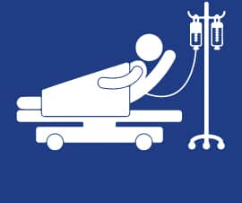
TARGET PARSONAS
The CARE system is designed to serve all members of society, with particular
emphasis on individuals at higher risk due to limited access to health services or
chronic health needs, including:
• People living with hypertension, diabetes, and cardiovascular diseases
• Residents of remote or underserved areas where medical centers are scarce
• Individuals who lack regular medical follow-up or health education resources
Notes:
<svg id="Layer_1" data-name="Layer 1" xmlns="http://www.w3.org/2000/svg" viewBox="0 0 223.96 256"><defs><style>.cls-1{fill:#fff;}</style></defs><path class="cls-1" d="M263,549.89h-7c-11.1-6-13-11-8.68-23.21A241.46,241.46,0,0,0,255.51,499c1.76-7.81,3.1-15.7,2.4-23.76-.55-6.32-2.61-9.14-7.75-10.15a60.89,60.89,0,0,0-23.34,0,8.39,8.39,0,0,0-7.22,7.26,47.38,47.38,0,0,0-.1,15.4c1.82,13.42,5.73,26.3,10.22,39,4.3,12.18,2.37,17.22-8.72,23.19h-7c-6.27-3-9.41-8.16-11.51-14.63-5.76-17.77-11.42-35.52-11.91-54.42-.26-10,1.25-19.56,6.78-28.2,1.41-2.2,2.39-2.51,4.42-.58a82.77,82.77,0,0,0,9,7.17c6.1,4.33,12.59,3.65,16.35-1.52s2.47-11.65-3.44-16a76.56,76.56,0,0,1-10.59-9.11c-2.83-3-4.55-6.29-4.18-10.72.4-4.67.09-9.41.09-15-5.54,7.49-5.68,15.23-1,22.58,3.75,5.87,9.12,10.07,14.62,14.17,4.75,3.54,5.77,8.44,2.87,12.57-3.06,4.36-8.11,5-13.19,1.5-7.05-4.85-13.44-10.42-18.26-17.58-8.46-12.57-9.32-25.7-2.47-39.23,3.58-7.08,8.8-12.86,14.68-18.14a18.64,18.64,0,0,1,13.22-4.82c12.66,0,25.33.12,38,0a12.58,12.58,0,0,1,11.63,6.31,38.82,38.82,0,0,0,9.2,10.22c1.23-1.18.79-2.41.92-3.49C280.28,382,281.4,373.06,286,365c1.08-1.89,2.39-3.42,2.38-6.15,0-2.45,2.52-5.74,5.68-5,6.78,1.69,12.87,5,15.27,12.19,2,6,6.29,9.16,11.69,11.37,3.13,1.29,5.12.85,6.09-3.07a170.14,170.14,0,0,0,5-34,10.46,10.46,0,0,0-2.25-7.29,24.44,24.44,0,0,1,5.75-34.83c2.91-2,6.39-2.65,9.39-4.38h9c1.67.67,3.34,1.33,5,2a24.65,24.65,0,0,1,14.87,26.25c-1.56,10.79-10.67,19.65-21.33,20.76-5.94.61-6.1.84-5.12,7.31,8.29-6.63,26.76-4.66,34.41,2.69a66.14,66.14,0,0,1,15.77,24c13,33.32,15.1,68,12.16,103.21-.27,3.23-2.47,4.54-5,5.55a60.91,60.91,0,0,1-18.51,3.86c-3.94.27-4.44,1.9-4.52,5.22-.33,13.49-.94,27-1.4,40.46-.16,4.6-1.79,8.48-5.58,11.18A13.64,13.64,0,0,1,353.08,535c.29-13.16.64-26.32,1.25-39.46.18-3.81-.43-5.45-4.79-5.93-11.58-1.28-13.28-3.49-13.83-15.27a209.87,209.87,0,0,1,.81-25.45c.52-7,1-14,1.56-22-3.28,2.17-6,2.08-8.64,1.93-5.64-.32-11.3-.62-16.92-1.26-2.48-.28-3.32,0-2.92,2.73a31.93,31.93,0,0,1-.05,10.46c-.86,4.72-2.08,9.39-7.64,10.55s-9.26-1.82-12.39-5.79c-3.9-4.94-5.94-10.79-7.32-16.8-.72-3.13-1.61-5.63-5-6.66-1.87-.56-3.65-2.14-3.07-4,1.76-5.63-2.51-6.33-6.09-8.48,0,10.24,0,19.9,0,29.55,0,1.37,0,2.62,1.35,3.5,15.28,10.22,17.83,25.56,16.84,42.25-1,17.46-6.39,33.91-11.7,50.4C272.45,541.75,269.32,547,263,549.89Zm37.94-147.52c-4.46.48-7.92-2-11.56-3.62-3.25-1.46-4.86-.71-6.13,2.43q-2.79,6.94-6.06,13.68c-1.36,2.8-1.08,4.56,2,5.86q10.8,4.54,21.45,9.46c2.72,1.25,4.72.91,5.35-2.06,1.42-6.63,5.65-8.08,11.64-7a21,21,0,0,0,4.48-.05c30.51-1.21,51.21-22.43,51.72-53,.08-4.22-.92-8-4.43-10.6a10.24,10.24,0,0,0-11.29-1.15c-4.1,2-6,5.48-6.17,10.07-.28,9.22-2.37,17.83-9.15,24.64-1.15,1.15-2.83,3-3.93,2.77-4.39-.87-7.33,1-10.13,3.91a4.83,4.83,0,0,1-5.15.92c-1-.33,1.06-1.71-.23-2.42-.24.24-.57.42-.71.71a3.68,3.68,0,0,1-4.44,2.32c-3.07-.73-.31-2.22-.31-3.35,0-1.41-1.24-1.44-2-1.71-8.13-2.76-14.34-8.2-20.36-14-4.6-4.46-6.82-9.15-3.51-15.74-1,.29-1,1-1.4,1.59-5.37,8.49-6.3,18.09-7.08,27.74-.16,2,1,1.8,2.46,2C291.55,396.55,296.11,399.76,300.94,402.37Zm-14.63,24.34a41.86,41.86,0,0,0,5.78,14.92c2.07,3.11,4.63,6.2,8.82,5.23s4-5.16,4.39-8.54c.18-1.71,1-4.6-.92-4.91C298.05,432.4,293,428.17,286.31,426.71ZM331.5,375.3a4.89,4.89,0,0,0,3.85-2.71c5.7-8.83,6.13-19.09,7.47-29,.35-2.59-3.19-2.32-5-3.16-1.32-.63-1.41,1-1.45,1.9A178.19,178.19,0,0,1,331.5,375.3Zm37.38,68.75c-5,1.25-10,2.56-15,3.72-1.72.4-1.54,1.29-1.16,2.54s.54,2.38,2.24,1.81l14.62-4.84a1.64,1.64,0,0,0,1.24-2.27C370.54,444,369.75,443.94,368.88,444.05Z" transform="translate(-186.98 -293.89)"/><path class="cls-1" d="M248.53,373.11a25.61,25.61,0,1,1-.1-51.22,25.61,25.61,0,0,1,.1,51.22Z" transform="translate(-186.98 -293.89)"/><path class="cls-1" d="M253.64,496.89a9,9,0,0,1-.51-1.08c-.61-3.76,1.1-8.76-1.49-11.05S244,484.15,240,484c-3.66-.14-7.35.21-11-.1s-4.78,1-4.71,4.4a42.09,42.09,0,0,1-.74,7.95,61.58,61.58,0,0,1-2.49-19.51c.1-2.63,1-3.83,3.9-3.78q13.49.23,27,0c2.85,0,3.81,1.1,3.92,3.76C256.18,483.39,255.13,489.87,253.64,496.89Z" transform="translate(-186.98 -293.89)"/><path class="cls-1" d="M254.14,469.49H224C228.8,465.29,245.94,465,254.14,469.49Z" transform="translate(-186.98 -293.89)"/><path class="cls-1" d="M238.84,520.33c1.64,0,3.3-.11,4.93,0,1.1.1,3.06-.67,2.81,1.51-.15,1.3-.34,3.11-2.46,3.1-3.78,0-7.57,0-11.35,0-2.11,0-2.18-1.92-2.34-3.2-.23-1.78,1.47-1.33,2.49-1.38C234.89,520.27,236.86,520.34,238.84,520.33Z" transform="translate(-186.98 -293.89)"/><path class="cls-1" d="M316.78,419a80.41,80.41,0,0,1-8.1-.47c-5.41-.79-8.45-4.64-8-9.65.48-4.85,4.41-8.13,9.83-7.74a73.05,73.05,0,0,0,13.95,0c17.82-2.17,28.33-13.31,29.48-31.41.06-1,0-2,.09-3,.35-5.8,3.79-9.36,9-9.27,4.89.09,8.64,3.72,8.53,9.17-.26,14.24-4.08,27.29-14.32,37.77C346.39,415.57,332.64,419,316.78,419Z" transform="translate(-186.98 -293.89)"/></svg><svg id="Layer_1" data-name="Layer 1" xmlns="http://www.w3.org/2000/svg" viewBox="0 0 223.96 256"><defs><style>.cls-1{fill:#fff;}</style></defs><path class="cls-1" d="M-269,263.89h-7c-11.1-6-13-11-8.68-23.21A241.46,241.46,0,0,0-276.49,213c1.76-7.81,3.1-15.7,2.4-23.76-.55-6.32-2.61-9.14-7.75-10.15a60.89,60.89,0,0,0-23.34,0,8.39,8.39,0,0,0-7.22,7.26,47.38,47.38,0,0,0-.1,15.4c1.82,13.42,5.73,26.3,10.22,39,4.3,12.18,2.37,17.22-8.72,23.19h-7c-6.27-3-9.41-8.16-11.51-14.63-5.76-17.77-11.42-35.52-11.91-54.42-.26-10,1.25-19.56,6.78-28.2,1.41-2.2,2.39-2.51,4.42-.58a82.77,82.77,0,0,0,9,7.17c6.1,4.33,12.59,3.65,16.35-1.52s2.47-11.65-3.44-16.05a76.56,76.56,0,0,1-10.59-9.11c-2.83-3-4.55-6.29-4.18-10.72.4-4.67.09-9.41.09-15-5.54,7.49-5.68,15.23-1,22.58,3.75,5.87,9.12,10.07,14.62,14.17,4.75,3.54,5.77,8.44,2.87,12.57-3.06,4.36-8.11,5-13.19,1.5-7-4.85-13.44-10.42-18.26-17.58-8.46-12.57-9.32-25.7-2.47-39.23,3.58-7.08,8.8-12.86,14.68-18.14a18.64,18.64,0,0,1,13.22-4.82c12.66,0,25.33.12,38,0a12.58,12.58,0,0,1,11.63,6.31,38.82,38.82,0,0,0,9.2,10.22c1.23-1.18.79-2.41.92-3.49C-251.72,96-250.6,87.06-246,79c1.08-1.89,2.39-3.42,2.38-6.15,0-2.45,2.52-5.74,5.68-5,6.78,1.69,12.87,5,15.27,12.19,2,6,6.29,9.16,11.69,11.37,3.13,1.29,5.12.85,6.09-3.07a170.14,170.14,0,0,0,5-34,10.46,10.46,0,0,0-2.25-7.29,24.44,24.44,0,0,1,5.75-34.83c2.91-2,6.39-2.65,9.39-4.38h9c1.67.67,3.34,1.33,5,2a24.65,24.65,0,0,1,14.87,26.25C-159.69,47-168.8,55.82-179.46,56.93c-5.94.61-6.1.84-5.12,7.31,8.29-6.63,26.76-4.66,34.41,2.69a66.14,66.14,0,0,1,15.77,24c13,33.32,15.1,68,12.16,103.21-.27,3.23-2.47,4.54-5,5.55a60.91,60.91,0,0,1-18.51,3.86c-3.94.27-4.44,1.9-4.52,5.22-.33,13.49-.94,27-1.4,40.46-.16,4.6-1.79,8.48-5.58,11.18a13,13,0,0,1-14.16,1.15,13,13,0,0,1-7.5-12.58c.29-13.16.64-26.32,1.25-39.46.18-3.81-.43-5.45-4.79-5.93-11.58-1.28-13.28-3.49-13.83-15.27a209.87,209.87,0,0,1,.81-25.45c.52-7,1-14,1.56-22-3.28,2.17-6,2.08-8.64,1.93-5.64-.32-11.3-.62-16.92-1.26-2.48-.28-3.32,0-2.92,2.73a31.93,31.93,0,0,1,0,10.46c-.86,4.72-2.08,9.39-7.64,10.55s-9.26-1.82-12.39-5.79c-3.9-4.94-5.94-10.79-7.32-16.8-.72-3.13-1.61-5.63-5-6.66-1.87-.56-3.65-2.14-3.07-4,1.76-5.63-2.51-6.33-6.09-8.48,0,10.24,0,19.9,0,29.55,0,1.37,0,2.62,1.35,3.5,15.28,10.22,17.83,25.56,16.84,42.25-1,17.46-6.39,33.91-11.7,50.4C-259.55,255.75-262.68,261-269,263.89Zm37.94-147.52c-4.46.48-7.92-2-11.56-3.62-3.25-1.46-4.86-.71-6.13,2.43q-2.79,6.94-6.06,13.68c-1.36,2.8-1.08,4.56,2,5.86q10.8,4.54,21.45,9.46c2.72,1.25,4.72.91,5.35-2.06,1.42-6.63,5.65-8.08,11.64-7a21,21,0,0,0,4.48-.05c30.51-1.21,51.21-22.43,51.72-53,.08-4.22-.92-7.95-4.43-10.6a10.24,10.24,0,0,0-11.29-1.15c-4.1,2-6,5.48-6.17,10.07-.28,9.22-2.37,17.83-9.15,24.64-1.15,1.15-2.83,3-3.93,2.77-4.39-.87-7.33,1-10.13,3.91a4.83,4.83,0,0,1-5.15.92c-1-.33,1.06-1.71-.23-2.42-.24.24-.57.42-.71.71a3.68,3.68,0,0,1-4.44,2.32c-3.07-.73-.31-2.22-.31-3.35,0-1.41-1.24-1.44-2.05-1.71-8.13-2.76-14.34-8.2-20.36-14-4.6-4.46-6.82-9.15-3.51-15.74-.95.29-1,1-1.4,1.59-5.37,8.49-6.3,18.09-7.08,27.74-.16,2,1,1.8,2.46,2C-240.45,110.55-235.89,113.76-231.06,116.37Zm-14.63,24.34a41.86,41.86,0,0,0,5.78,14.92c2.07,3.11,4.63,6.2,8.82,5.23s4-5.16,4.39-8.54c.18-1.71,1-4.6-.92-4.91C-233.95,146.4-239,142.17-245.69,140.71ZM-200.5,89.3a4.89,4.89,0,0,0,3.85-2.71c5.7-8.83,6.13-19.09,7.47-29,.35-2.59-3.19-2.32-5-3.16-1.32-.63-1.41,1-1.45,1.9A178.19,178.19,0,0,1-200.5,89.3Zm37.38,68.75c-5,1.25-10,2.56-15,3.72-1.72.4-1.54,1.29-1.16,2.54s.54,2.38,2.24,1.81l14.62-4.84a1.64,1.64,0,0,0,1.24-2.27C-161.46,158-162.25,157.94-163.12,158.05Z" transform="translate(345.02 -7.89)"/><path class="cls-1" d="M-283.47,87.11a25.36,25.36,0,0,1-25.75-25.53,25.48,25.48,0,0,1,25.65-25.69A25.66,25.66,0,0,1-258,61.23,25.52,25.52,0,0,1-283.47,87.11Z" transform="translate(345.02 -7.89)"/><path class="cls-1" d="M-278.36,210.89a9,9,0,0,1-.51-1.08c-.61-3.76,1.1-8.76-1.49-11.05s-7.65-.61-11.6-.76c-3.66-.14-7.35.21-11-.1s-4.78,1-4.71,4.4a42.09,42.09,0,0,1-.74,7.95,61.58,61.58,0,0,1-2.49-19.51c.1-2.63,1-3.83,3.9-3.78q13.49.22,27,0c2.85,0,3.81,1.1,3.92,3.76C-275.82,197.39-276.87,203.87-278.36,210.89Z" transform="translate(345.02 -7.89)"/><path class="cls-1" d="M-277.86,183.49H-308C-303.2,179.29-286.06,179-277.86,183.49Z" transform="translate(345.02 -7.89)"/><path class="cls-1" d="M-293.16,234.33c1.64,0,3.3-.11,4.93,0,1.1.1,3.06-.67,2.81,1.51-.15,1.3-.34,3.11-2.46,3.1-3.78,0-7.57,0-11.35,0-2.11,0-2.18-1.92-2.34-3.2-.23-1.78,1.47-1.33,2.49-1.38C-297.11,234.27-295.14,234.34-293.16,234.33Z" transform="translate(345.02 -7.89)"/><path class="cls-1" d="M-215.22,133a80.41,80.41,0,0,1-8.1-.47c-5.41-.79-8.45-4.64-8-9.65.48-4.85,4.41-8.13,9.83-7.74a73.05,73.05,0,0,0,13.95,0c17.82-2.17,28.33-13.31,29.48-31.41.06-1,0-2,.09-3,.35-5.8,3.79-9.36,9-9.27,4.89.09,8.64,3.72,8.53,9.17-.26,14.24-4.08,27.29-14.32,37.77C-185.61,129.57-199.36,133-215.22,133Z" transform="translate(345.02 -7.89)"/></svg>

Slide 26

TARGET PARSONAS
The CARE system is designed to serve all members of society, with particular
emphasis on individuals at higher risk due to limited access to health services or
chronic health needs, including:
• People living with hypertension, diabetes, and cardiovascular diseases
• Residents of remote or underserved areas where medical centers are scarce
• Individuals who lack regular medical follow-up or health education resources
Notes:
<svg id="Layer_1" data-name="Layer 1" xmlns="http://www.w3.org/2000/svg" viewBox="0 0 223.96 256"><defs><style>.cls-1{fill:#fff;}</style></defs><path class="cls-1" d="M263,549.89h-7c-11.1-6-13-11-8.68-23.21A241.46,241.46,0,0,0,255.51,499c1.76-7.81,3.1-15.7,2.4-23.76-.55-6.32-2.61-9.14-7.75-10.15a60.89,60.89,0,0,0-23.34,0,8.39,8.39,0,0,0-7.22,7.26,47.38,47.38,0,0,0-.1,15.4c1.82,13.42,5.73,26.3,10.22,39,4.3,12.18,2.37,17.22-8.72,23.19h-7c-6.27-3-9.41-8.16-11.51-14.63-5.76-17.77-11.42-35.52-11.91-54.42-.26-10,1.25-19.56,6.78-28.2,1.41-2.2,2.39-2.51,4.42-.58a82.77,82.77,0,0,0,9,7.17c6.1,4.33,12.59,3.65,16.35-1.52s2.47-11.65-3.44-16a76.56,76.56,0,0,1-10.59-9.11c-2.83-3-4.55-6.29-4.18-10.72.4-4.67.09-9.41.09-15-5.54,7.49-5.68,15.23-1,22.58,3.75,5.87,9.12,10.07,14.62,14.17,4.75,3.54,5.77,8.44,2.87,12.57-3.06,4.36-8.11,5-13.19,1.5-7.05-4.85-13.44-10.42-18.26-17.58-8.46-12.57-9.32-25.7-2.47-39.23,3.58-7.08,8.8-12.86,14.68-18.14a18.64,18.64,0,0,1,13.22-4.82c12.66,0,25.33.12,38,0a12.58,12.58,0,0,1,11.63,6.31,38.82,38.82,0,0,0,9.2,10.22c1.23-1.18.79-2.41.92-3.49C280.28,382,281.4,373.06,286,365c1.08-1.89,2.39-3.42,2.38-6.15,0-2.45,2.52-5.74,5.68-5,6.78,1.69,12.87,5,15.27,12.19,2,6,6.29,9.16,11.69,11.37,3.13,1.29,5.12.85,6.09-3.07a170.14,170.14,0,0,0,5-34,10.46,10.46,0,0,0-2.25-7.29,24.44,24.44,0,0,1,5.75-34.83c2.91-2,6.39-2.65,9.39-4.38h9c1.67.67,3.34,1.33,5,2a24.65,24.65,0,0,1,14.87,26.25c-1.56,10.79-10.67,19.65-21.33,20.76-5.94.61-6.1.84-5.12,7.31,8.29-6.63,26.76-4.66,34.41,2.69a66.14,66.14,0,0,1,15.77,24c13,33.32,15.1,68,12.16,103.21-.27,3.23-2.47,4.54-5,5.55a60.91,60.91,0,0,1-18.51,3.86c-3.94.27-4.44,1.9-4.52,5.22-.33,13.49-.94,27-1.4,40.46-.16,4.6-1.79,8.48-5.58,11.18A13.64,13.64,0,0,1,353.08,535c.29-13.16.64-26.32,1.25-39.46.18-3.81-.43-5.45-4.79-5.93-11.58-1.28-13.28-3.49-13.83-15.27a209.87,209.87,0,0,1,.81-25.45c.52-7,1-14,1.56-22-3.28,2.17-6,2.08-8.64,1.93-5.64-.32-11.3-.62-16.92-1.26-2.48-.28-3.32,0-2.92,2.73a31.93,31.93,0,0,1-.05,10.46c-.86,4.72-2.08,9.39-7.64,10.55s-9.26-1.82-12.39-5.79c-3.9-4.94-5.94-10.79-7.32-16.8-.72-3.13-1.61-5.63-5-6.66-1.87-.56-3.65-2.14-3.07-4,1.76-5.63-2.51-6.33-6.09-8.48,0,10.24,0,19.9,0,29.55,0,1.37,0,2.62,1.35,3.5,15.28,10.22,17.83,25.56,16.84,42.25-1,17.46-6.39,33.91-11.7,50.4C272.45,541.75,269.32,547,263,549.89Zm37.94-147.52c-4.46.48-7.92-2-11.56-3.62-3.25-1.46-4.86-.71-6.13,2.43q-2.79,6.94-6.06,13.68c-1.36,2.8-1.08,4.56,2,5.86q10.8,4.54,21.45,9.46c2.72,1.25,4.72.91,5.35-2.06,1.42-6.63,5.65-8.08,11.64-7a21,21,0,0,0,4.48-.05c30.51-1.21,51.21-22.43,51.72-53,.08-4.22-.92-8-4.43-10.6a10.24,10.24,0,0,0-11.29-1.15c-4.1,2-6,5.48-6.17,10.07-.28,9.22-2.37,17.83-9.15,24.64-1.15,1.15-2.83,3-3.93,2.77-4.39-.87-7.33,1-10.13,3.91a4.83,4.83,0,0,1-5.15.92c-1-.33,1.06-1.71-.23-2.42-.24.24-.57.42-.71.71a3.68,3.68,0,0,1-4.44,2.32c-3.07-.73-.31-2.22-.31-3.35,0-1.41-1.24-1.44-2-1.71-8.13-2.76-14.34-8.2-20.36-14-4.6-4.46-6.82-9.15-3.51-15.74-1,.29-1,1-1.4,1.59-5.37,8.49-6.3,18.09-7.08,27.74-.16,2,1,1.8,2.46,2C291.55,396.55,296.11,399.76,300.94,402.37Zm-14.63,24.34a41.86,41.86,0,0,0,5.78,14.92c2.07,3.11,4.63,6.2,8.82,5.23s4-5.16,4.39-8.54c.18-1.71,1-4.6-.92-4.91C298.05,432.4,293,428.17,286.31,426.71ZM331.5,375.3a4.89,4.89,0,0,0,3.85-2.71c5.7-8.83,6.13-19.09,7.47-29,.35-2.59-3.19-2.32-5-3.16-1.32-.63-1.41,1-1.45,1.9A178.19,178.19,0,0,1,331.5,375.3Zm37.38,68.75c-5,1.25-10,2.56-15,3.72-1.72.4-1.54,1.29-1.16,2.54s.54,2.38,2.24,1.81l14.62-4.84a1.64,1.64,0,0,0,1.24-2.27C370.54,444,369.75,443.94,368.88,444.05Z" transform="translate(-186.98 -293.89)"/><path class="cls-1" d="M248.53,373.11a25.61,25.61,0,1,1-.1-51.22,25.61,25.61,0,0,1,.1,51.22Z" transform="translate(-186.98 -293.89)"/><path class="cls-1" d="M253.64,496.89a9,9,0,0,1-.51-1.08c-.61-3.76,1.1-8.76-1.49-11.05S244,484.15,240,484c-3.66-.14-7.35.21-11-.1s-4.78,1-4.71,4.4a42.09,42.09,0,0,1-.74,7.95,61.58,61.58,0,0,1-2.49-19.51c.1-2.63,1-3.83,3.9-3.78q13.49.23,27,0c2.85,0,3.81,1.1,3.92,3.76C256.18,483.39,255.13,489.87,253.64,496.89Z" transform="translate(-186.98 -293.89)"/><path class="cls-1" d="M254.14,469.49H224C228.8,465.29,245.94,465,254.14,469.49Z" transform="translate(-186.98 -293.89)"/><path class="cls-1" d="M238.84,520.33c1.64,0,3.3-.11,4.93,0,1.1.1,3.06-.67,2.81,1.51-.15,1.3-.34,3.11-2.46,3.1-3.78,0-7.57,0-11.35,0-2.11,0-2.18-1.92-2.34-3.2-.23-1.78,1.47-1.33,2.49-1.38C234.89,520.27,236.86,520.34,238.84,520.33Z" transform="translate(-186.98 -293.89)"/><path class="cls-1" d="M316.78,419a80.41,80.41,0,0,1-8.1-.47c-5.41-.79-8.45-4.64-8-9.65.48-4.85,4.41-8.13,9.83-7.74a73.05,73.05,0,0,0,13.95,0c17.82-2.17,28.33-13.31,29.48-31.41.06-1,0-2,.09-3,.35-5.8,3.79-9.36,9-9.27,4.89.09,8.64,3.72,8.53,9.17-.26,14.24-4.08,27.29-14.32,37.77C346.39,415.57,332.64,419,316.78,419Z" transform="translate(-186.98 -293.89)"/></svg><svg id="Layer_1" data-name="Layer 1" xmlns="http://www.w3.org/2000/svg" viewBox="0 0 223.96 256"><defs><style>.cls-1{fill:#fff;}</style></defs><path class="cls-1" d="M-269,263.89h-7c-11.1-6-13-11-8.68-23.21A241.46,241.46,0,0,0-276.49,213c1.76-7.81,3.1-15.7,2.4-23.76-.55-6.32-2.61-9.14-7.75-10.15a60.89,60.89,0,0,0-23.34,0,8.39,8.39,0,0,0-7.22,7.26,47.38,47.38,0,0,0-.1,15.4c1.82,13.42,5.73,26.3,10.22,39,4.3,12.18,2.37,17.22-8.72,23.19h-7c-6.27-3-9.41-8.16-11.51-14.63-5.76-17.77-11.42-35.52-11.91-54.42-.26-10,1.25-19.56,6.78-28.2,1.41-2.2,2.39-2.51,4.42-.58a82.77,82.77,0,0,0,9,7.17c6.1,4.33,12.59,3.65,16.35-1.52s2.47-11.65-3.44-16.05a76.56,76.56,0,0,1-10.59-9.11c-2.83-3-4.55-6.29-4.18-10.72.4-4.67.09-9.41.09-15-5.54,7.49-5.68,15.23-1,22.58,3.75,5.87,9.12,10.07,14.62,14.17,4.75,3.54,5.77,8.44,2.87,12.57-3.06,4.36-8.11,5-13.19,1.5-7-4.85-13.44-10.42-18.26-17.58-8.46-12.57-9.32-25.7-2.47-39.23,3.58-7.08,8.8-12.86,14.68-18.14a18.64,18.64,0,0,1,13.22-4.82c12.66,0,25.33.12,38,0a12.58,12.58,0,0,1,11.63,6.31,38.82,38.82,0,0,0,9.2,10.22c1.23-1.18.79-2.41.92-3.49C-251.72,96-250.6,87.06-246,79c1.08-1.89,2.39-3.42,2.38-6.15,0-2.45,2.52-5.74,5.68-5,6.78,1.69,12.87,5,15.27,12.19,2,6,6.29,9.16,11.69,11.37,3.13,1.29,5.12.85,6.09-3.07a170.14,170.14,0,0,0,5-34,10.46,10.46,0,0,0-2.25-7.29,24.44,24.44,0,0,1,5.75-34.83c2.91-2,6.39-2.65,9.39-4.38h9c1.67.67,3.34,1.33,5,2a24.65,24.65,0,0,1,14.87,26.25C-159.69,47-168.8,55.82-179.46,56.93c-5.94.61-6.1.84-5.12,7.31,8.29-6.63,26.76-4.66,34.41,2.69a66.14,66.14,0,0,1,15.77,24c13,33.32,15.1,68,12.16,103.21-.27,3.23-2.47,4.54-5,5.55a60.91,60.91,0,0,1-18.51,3.86c-3.94.27-4.44,1.9-4.52,5.22-.33,13.49-.94,27-1.4,40.46-.16,4.6-1.79,8.48-5.58,11.18a13,13,0,0,1-14.16,1.15,13,13,0,0,1-7.5-12.58c.29-13.16.64-26.32,1.25-39.46.18-3.81-.43-5.45-4.79-5.93-11.58-1.28-13.28-3.49-13.83-15.27a209.87,209.87,0,0,1,.81-25.45c.52-7,1-14,1.56-22-3.28,2.17-6,2.08-8.64,1.93-5.64-.32-11.3-.62-16.92-1.26-2.48-.28-3.32,0-2.92,2.73a31.93,31.93,0,0,1,0,10.46c-.86,4.72-2.08,9.39-7.64,10.55s-9.26-1.82-12.39-5.79c-3.9-4.94-5.94-10.79-7.32-16.8-.72-3.13-1.61-5.63-5-6.66-1.87-.56-3.65-2.14-3.07-4,1.76-5.63-2.51-6.33-6.09-8.48,0,10.24,0,19.9,0,29.55,0,1.37,0,2.62,1.35,3.5,15.28,10.22,17.83,25.56,16.84,42.25-1,17.46-6.39,33.91-11.7,50.4C-259.55,255.75-262.68,261-269,263.89Zm37.94-147.52c-4.46.48-7.92-2-11.56-3.62-3.25-1.46-4.86-.71-6.13,2.43q-2.79,6.94-6.06,13.68c-1.36,2.8-1.08,4.56,2,5.86q10.8,4.54,21.45,9.46c2.72,1.25,4.72.91,5.35-2.06,1.42-6.63,5.65-8.08,11.64-7a21,21,0,0,0,4.48-.05c30.51-1.21,51.21-22.43,51.72-53,.08-4.22-.92-7.95-4.43-10.6a10.24,10.24,0,0,0-11.29-1.15c-4.1,2-6,5.48-6.17,10.07-.28,9.22-2.37,17.83-9.15,24.64-1.15,1.15-2.83,3-3.93,2.77-4.39-.87-7.33,1-10.13,3.91a4.83,4.83,0,0,1-5.15.92c-1-.33,1.06-1.71-.23-2.42-.24.24-.57.42-.71.71a3.68,3.68,0,0,1-4.44,2.32c-3.07-.73-.31-2.22-.31-3.35,0-1.41-1.24-1.44-2.05-1.71-8.13-2.76-14.34-8.2-20.36-14-4.6-4.46-6.82-9.15-3.51-15.74-.95.29-1,1-1.4,1.59-5.37,8.49-6.3,18.09-7.08,27.74-.16,2,1,1.8,2.46,2C-240.45,110.55-235.89,113.76-231.06,116.37Zm-14.63,24.34a41.86,41.86,0,0,0,5.78,14.92c2.07,3.11,4.63,6.2,8.82,5.23s4-5.16,4.39-8.54c.18-1.71,1-4.6-.92-4.91C-233.95,146.4-239,142.17-245.69,140.71ZM-200.5,89.3a4.89,4.89,0,0,0,3.85-2.71c5.7-8.83,6.13-19.09,7.47-29,.35-2.59-3.19-2.32-5-3.16-1.32-.63-1.41,1-1.45,1.9A178.19,178.19,0,0,1-200.5,89.3Zm37.38,68.75c-5,1.25-10,2.56-15,3.72-1.72.4-1.54,1.29-1.16,2.54s.54,2.38,2.24,1.81l14.62-4.84a1.64,1.64,0,0,0,1.24-2.27C-161.46,158-162.25,157.94-163.12,158.05Z" transform="translate(345.02 -7.89)"/><path class="cls-1" d="M-283.47,87.11a25.36,25.36,0,0,1-25.75-25.53,25.48,25.48,0,0,1,25.65-25.69A25.66,25.66,0,0,1-258,61.23,25.52,25.52,0,0,1-283.47,87.11Z" transform="translate(345.02 -7.89)"/><path class="cls-1" d="M-278.36,210.89a9,9,0,0,1-.51-1.08c-.61-3.76,1.1-8.76-1.49-11.05s-7.65-.61-11.6-.76c-3.66-.14-7.35.21-11-.1s-4.78,1-4.71,4.4a42.09,42.09,0,0,1-.74,7.95,61.58,61.58,0,0,1-2.49-19.51c.1-2.63,1-3.83,3.9-3.78q13.49.22,27,0c2.85,0,3.81,1.1,3.92,3.76C-275.82,197.39-276.87,203.87-278.36,210.89Z" transform="translate(345.02 -7.89)"/><path class="cls-1" d="M-277.86,183.49H-308C-303.2,179.29-286.06,179-277.86,183.49Z" transform="translate(345.02 -7.89)"/><path class="cls-1" d="M-293.16,234.33c1.64,0,3.3-.11,4.93,0,1.1.1,3.06-.67,2.81,1.51-.15,1.3-.34,3.11-2.46,3.1-3.78,0-7.57,0-11.35,0-2.11,0-2.18-1.92-2.34-3.2-.23-1.78,1.47-1.33,2.49-1.38C-297.11,234.27-295.14,234.34-293.16,234.33Z" transform="translate(345.02 -7.89)"/><path class="cls-1" d="M-215.22,133a80.41,80.41,0,0,1-8.1-.47c-5.41-.79-8.45-4.64-8-9.65.48-4.85,4.41-8.13,9.83-7.74a73.05,73.05,0,0,0,13.95,0c17.82-2.17,28.33-13.31,29.48-31.41.06-1,0-2,.09-3,.35-5.8,3.79-9.36,9-9.27,4.89.09,8.64,3.72,8.53,9.17-.26,14.24-4.08,27.29-14.32,37.77C-185.61,129.57-199.36,133-215.22,133Z" transform="translate(345.02 -7.89)"/></svg>

Slide 27

TARGET PARSONAS
The CARE system is designed to serve all members of society, with particular
emphasis on individuals at higher risk due to limited access to health services or
chronic health needs, including:
• People living with hypertension, diabetes, and cardiovascular diseases
• Residents of remote or underserved areas where medical centers are scarce
• Individuals who lack regular medical follow-up or health education resources

Slide 28

TARGET PARSONAS
The CARE system is designed to serve all members of society, with particular
emphasis on individuals at higher risk due to limited access to health services or
chronic health needs, including:
• People living with hypertension, diabetes, and cardiovascular diseases
• Residents of remote or underserved areas where medical centers are scarce
• Individuals who lack regular medical follow-up or health education resources

Slide 29
DEVICE FUNCTIONS
Health Monitoring: Measures key vital signs including blood pressure and blood sugar levels with high accuracy.
Automated Nutritional Response: Dispenses salty water or sugary water based on the user’s blood sugar result to help rebalance levels.
Blood Pressure Support: Provides natural, medically-informed juices designed to assist in stabilizing blood pressure.
User-Friendly Interaction: Features a simple, intuitive interface that people of all ages can use comfortably and without assistance.
Instant Reporting: Displays real-time results on-screen and provides clear guidance or suggestions based on the readings.
Self-Service Operation: Allows users to complete the entire process independently, making it suitable for public spaces.

Slide 30
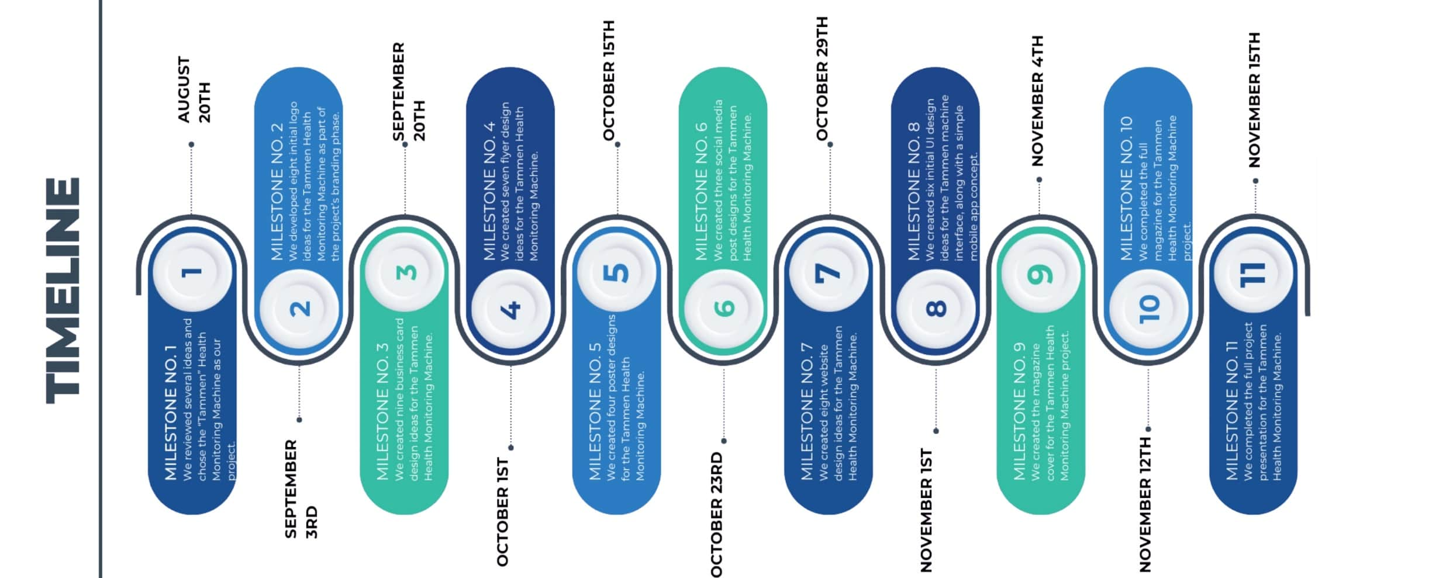
TIMELINE

Slide 31
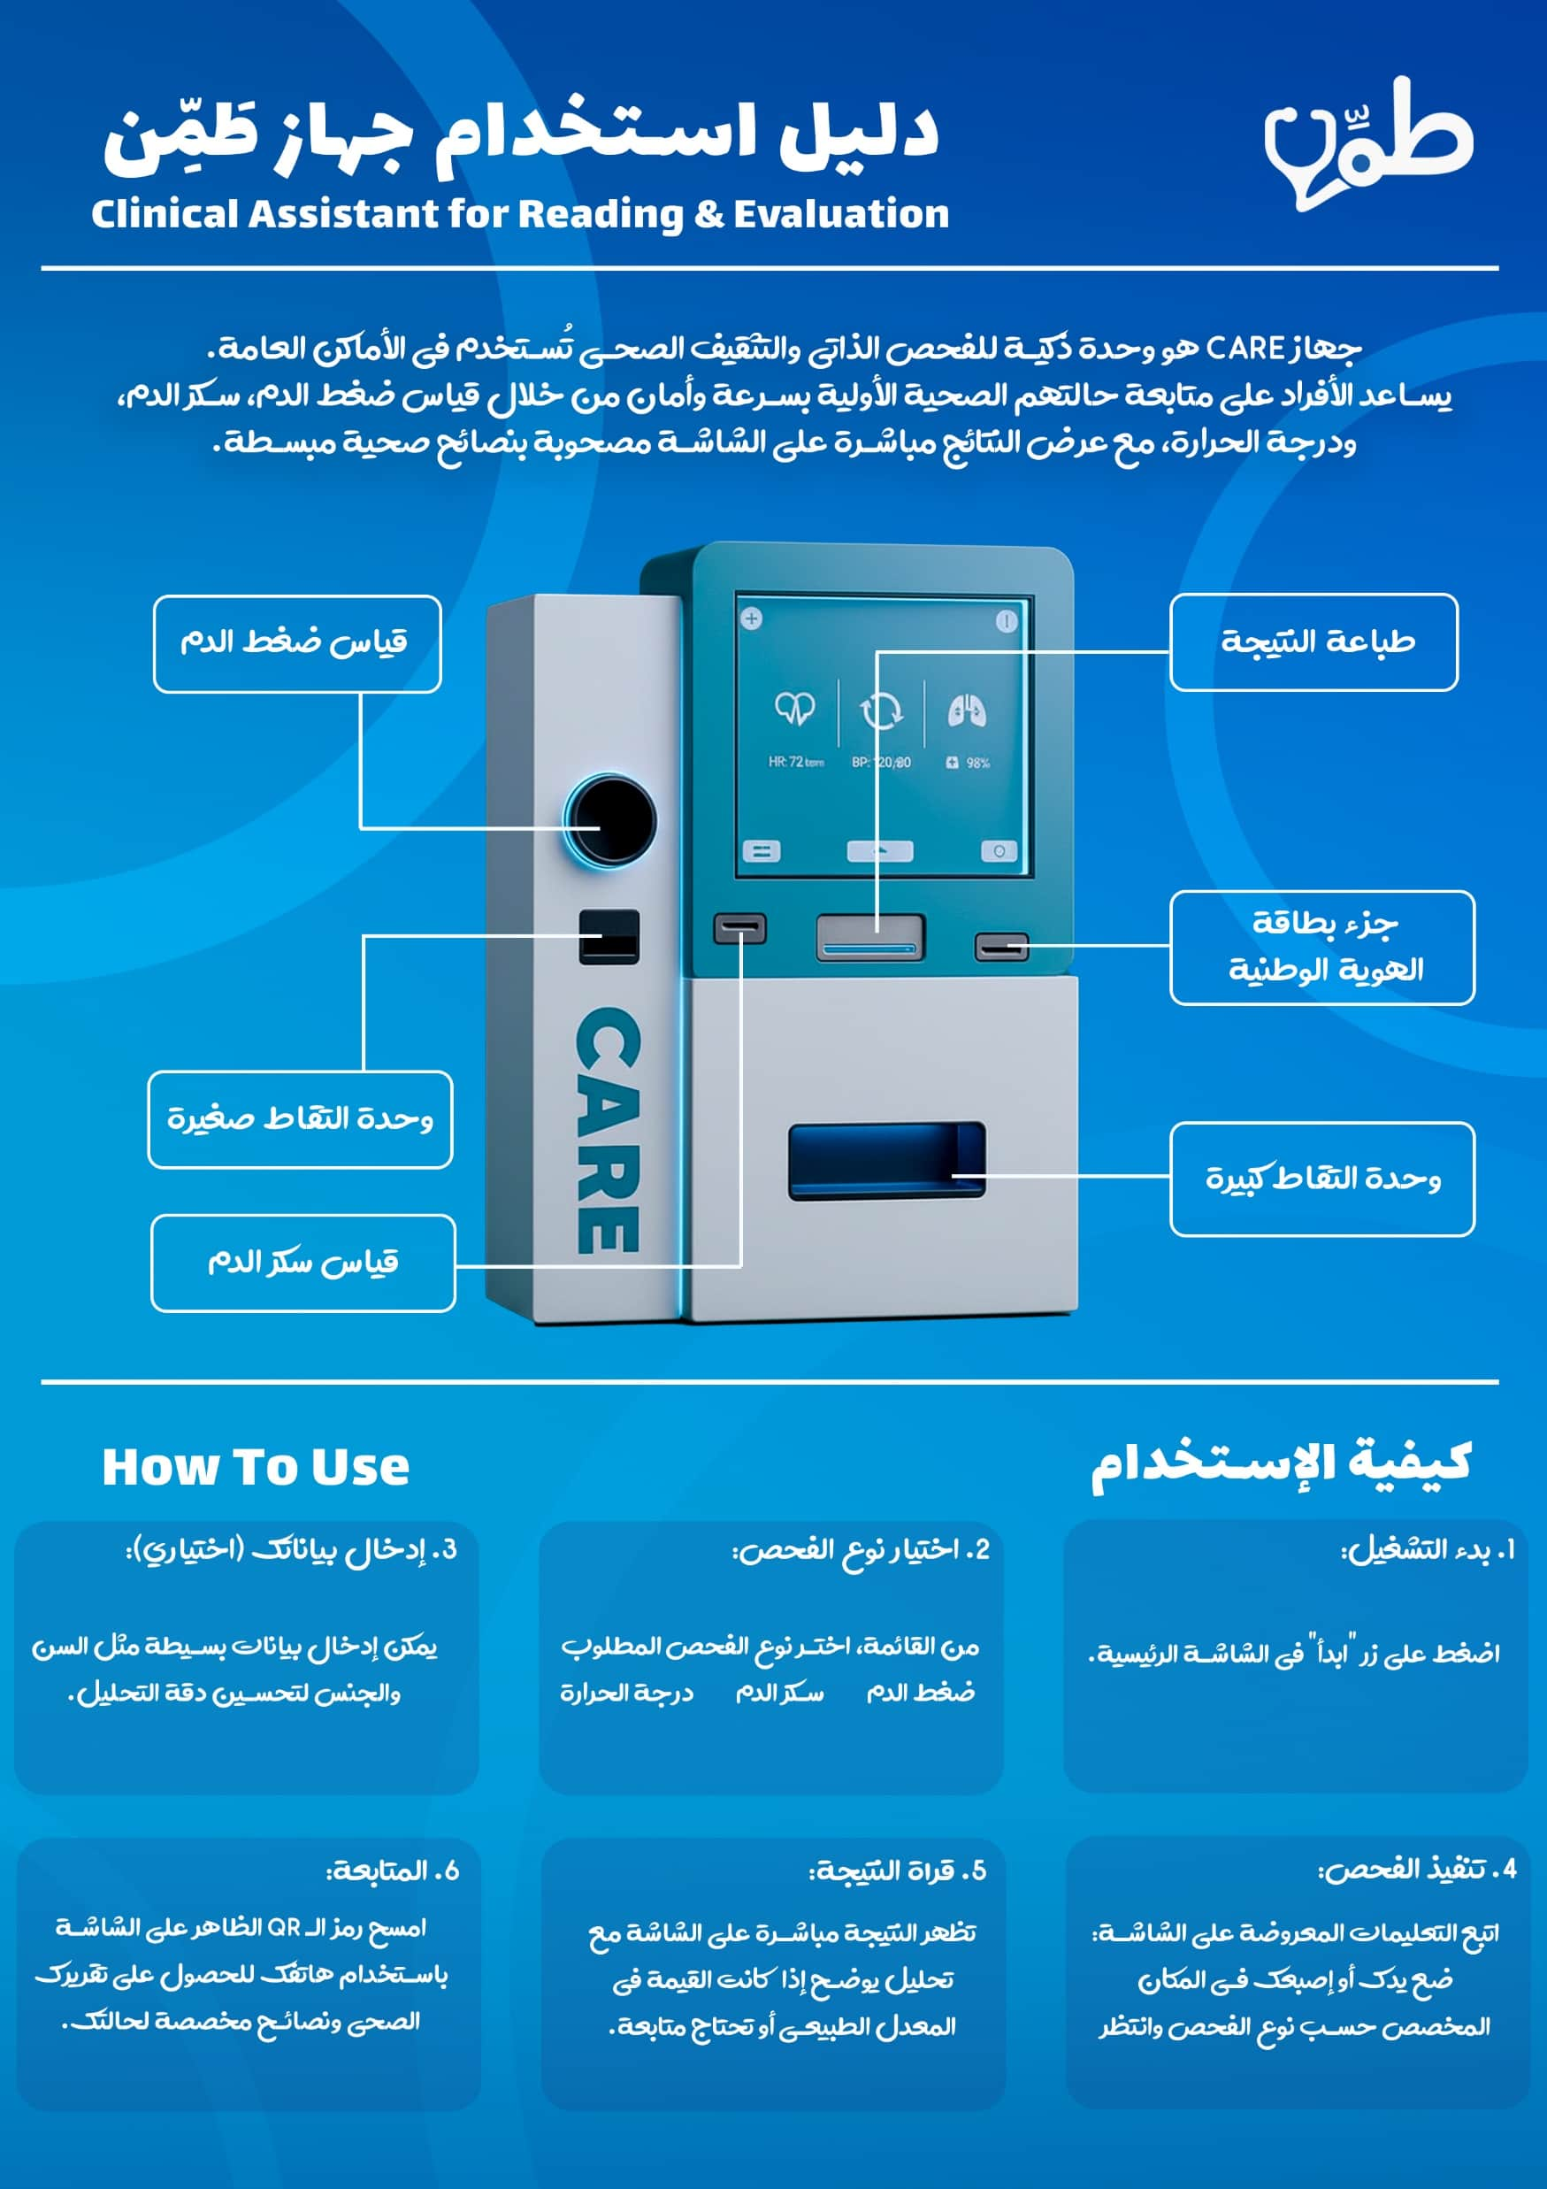
HOW TO USE

Slide 32
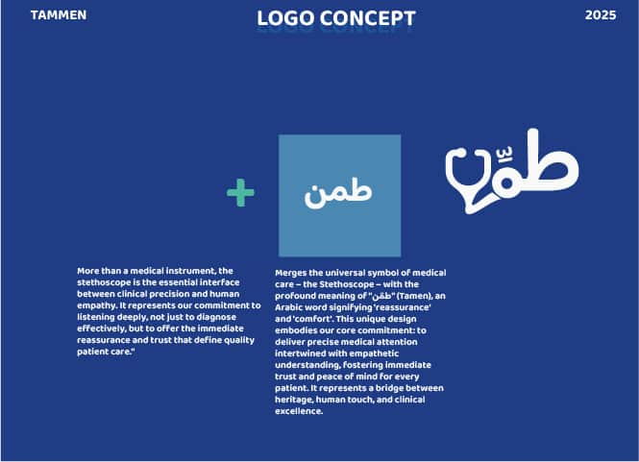

BRAND IDENTITY
=

Slide 33
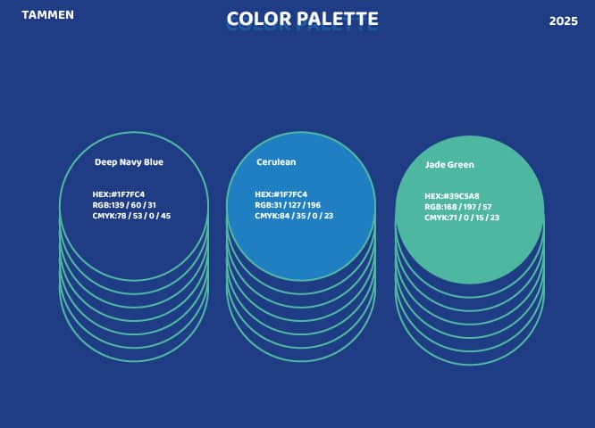
BRAND IDENTITY

Slide 34
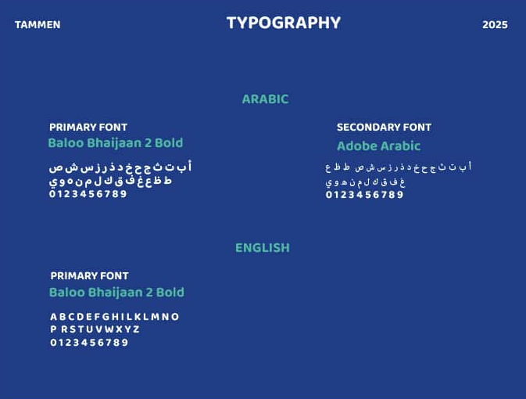
BRAND IDENTITY

Slide 35
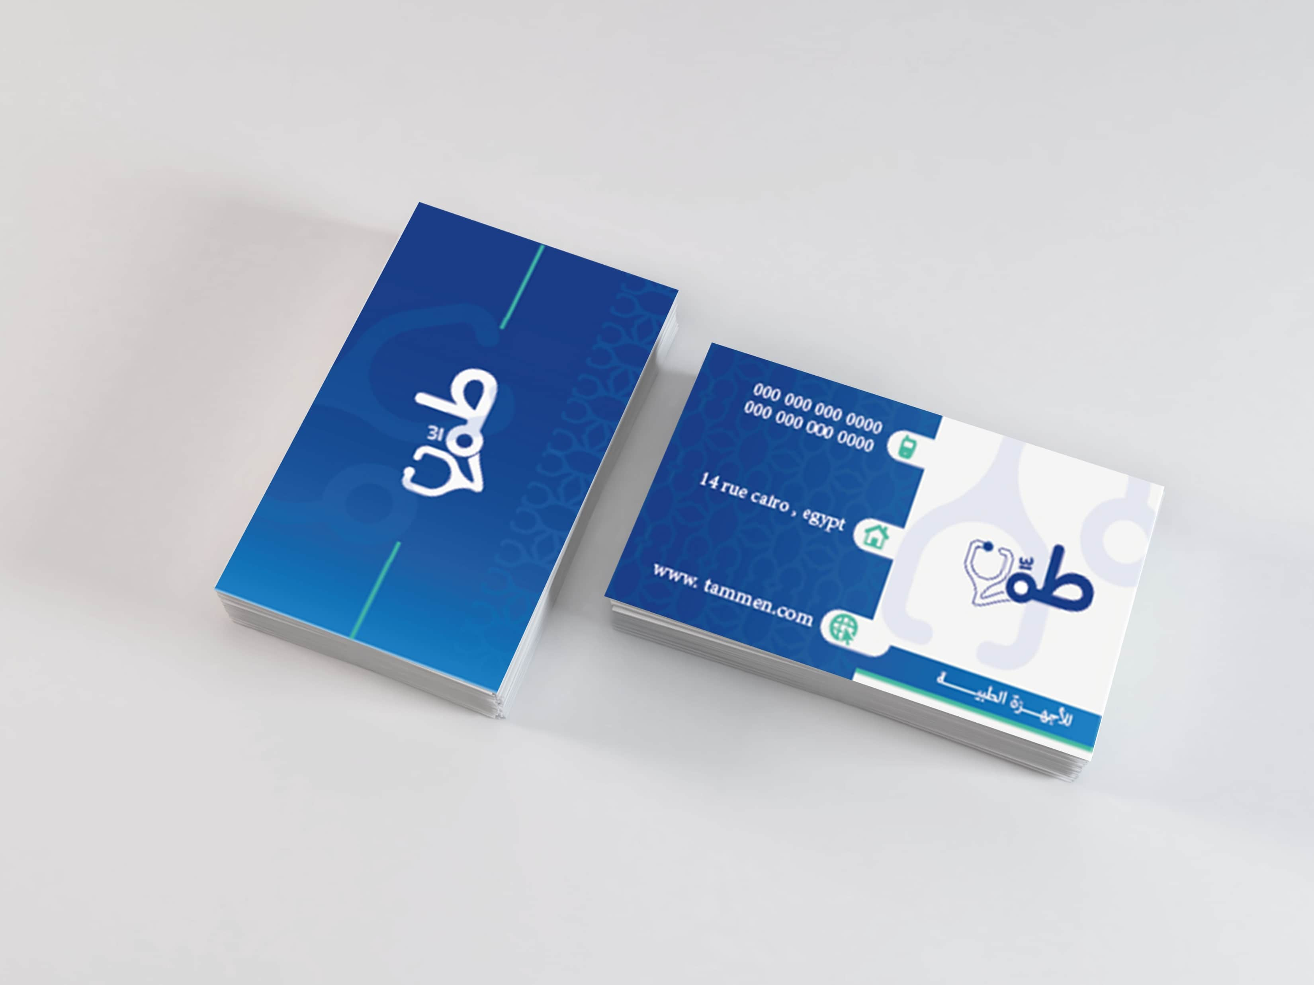
MARKETING
BUSINESS CARD
01

Slide 36
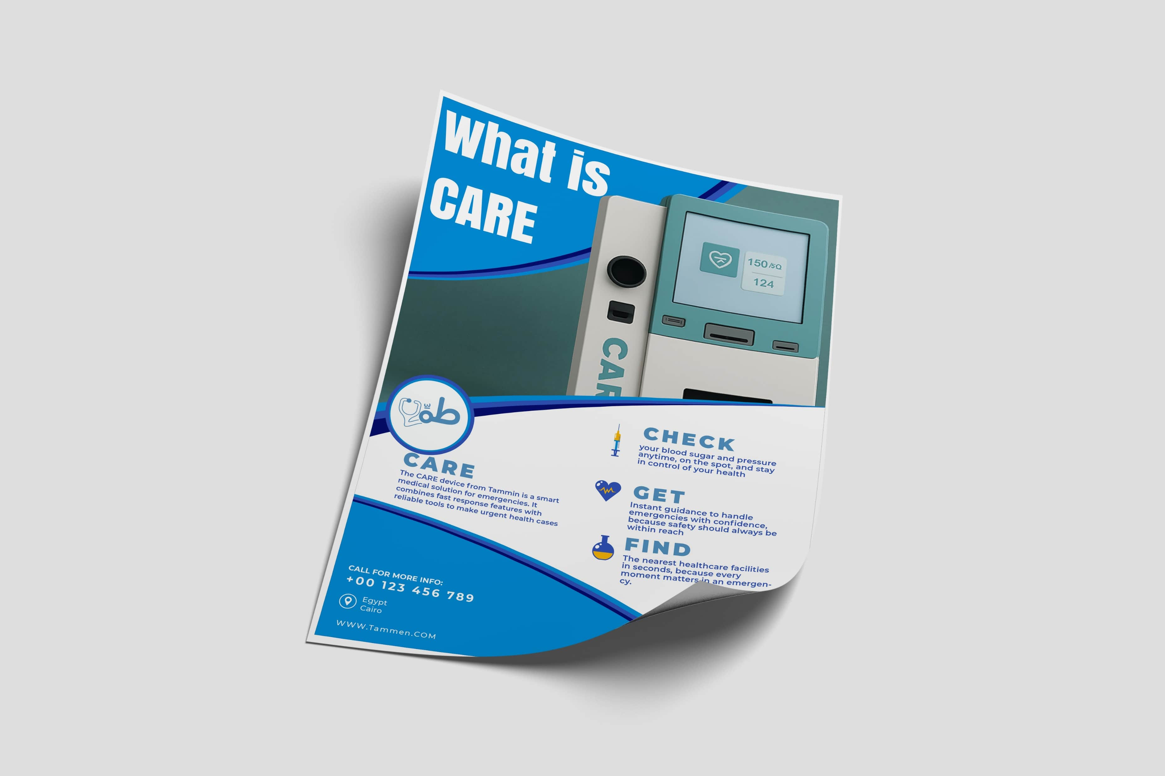
MARKETING
FLYER
02

Slide 37
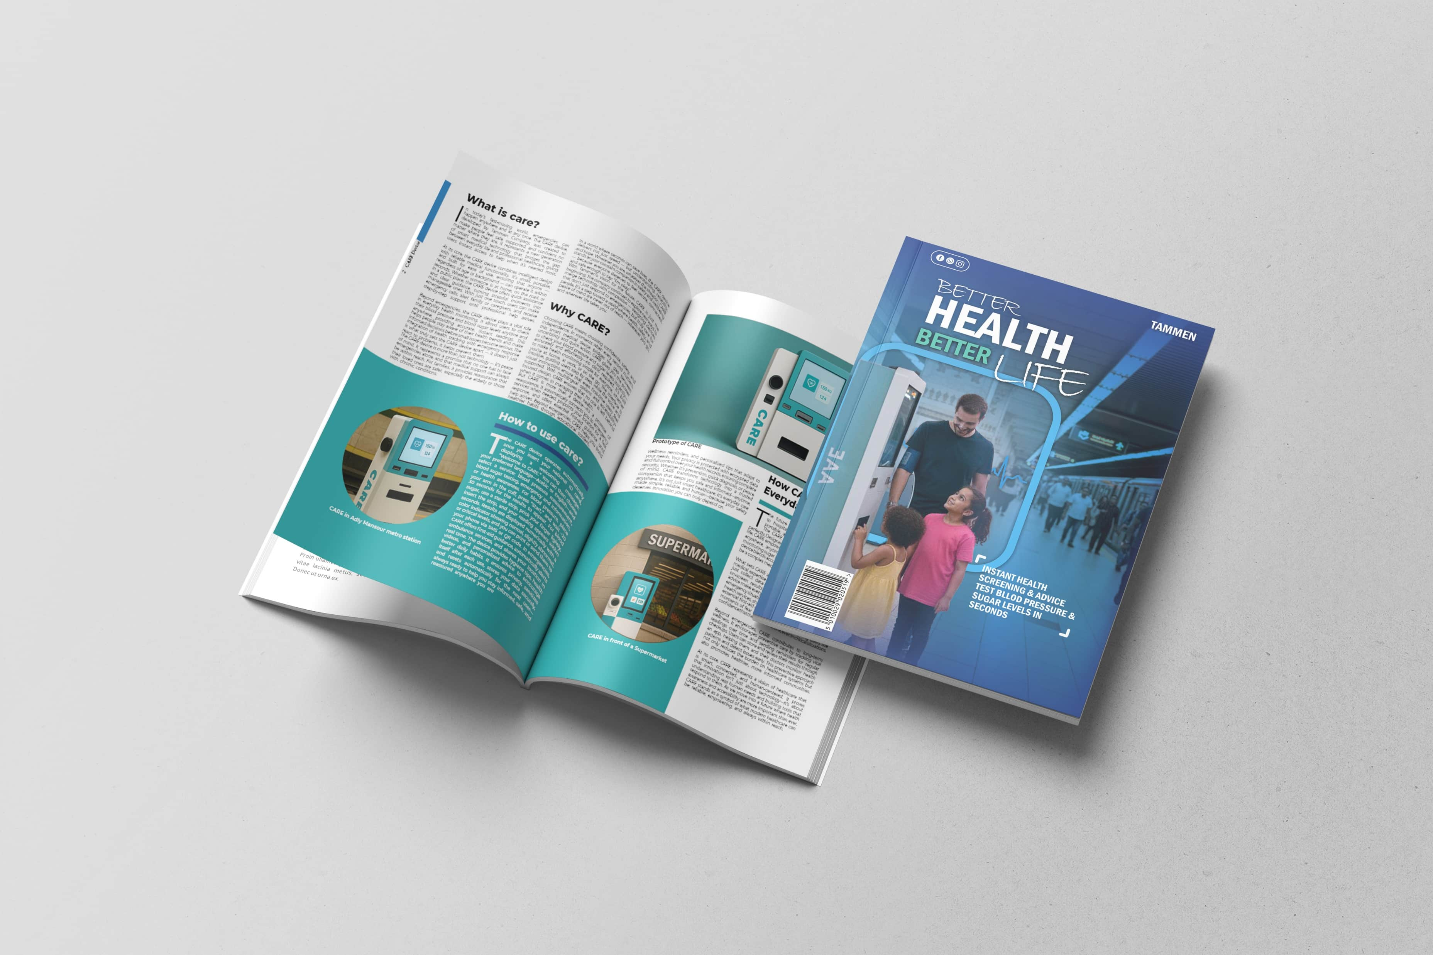
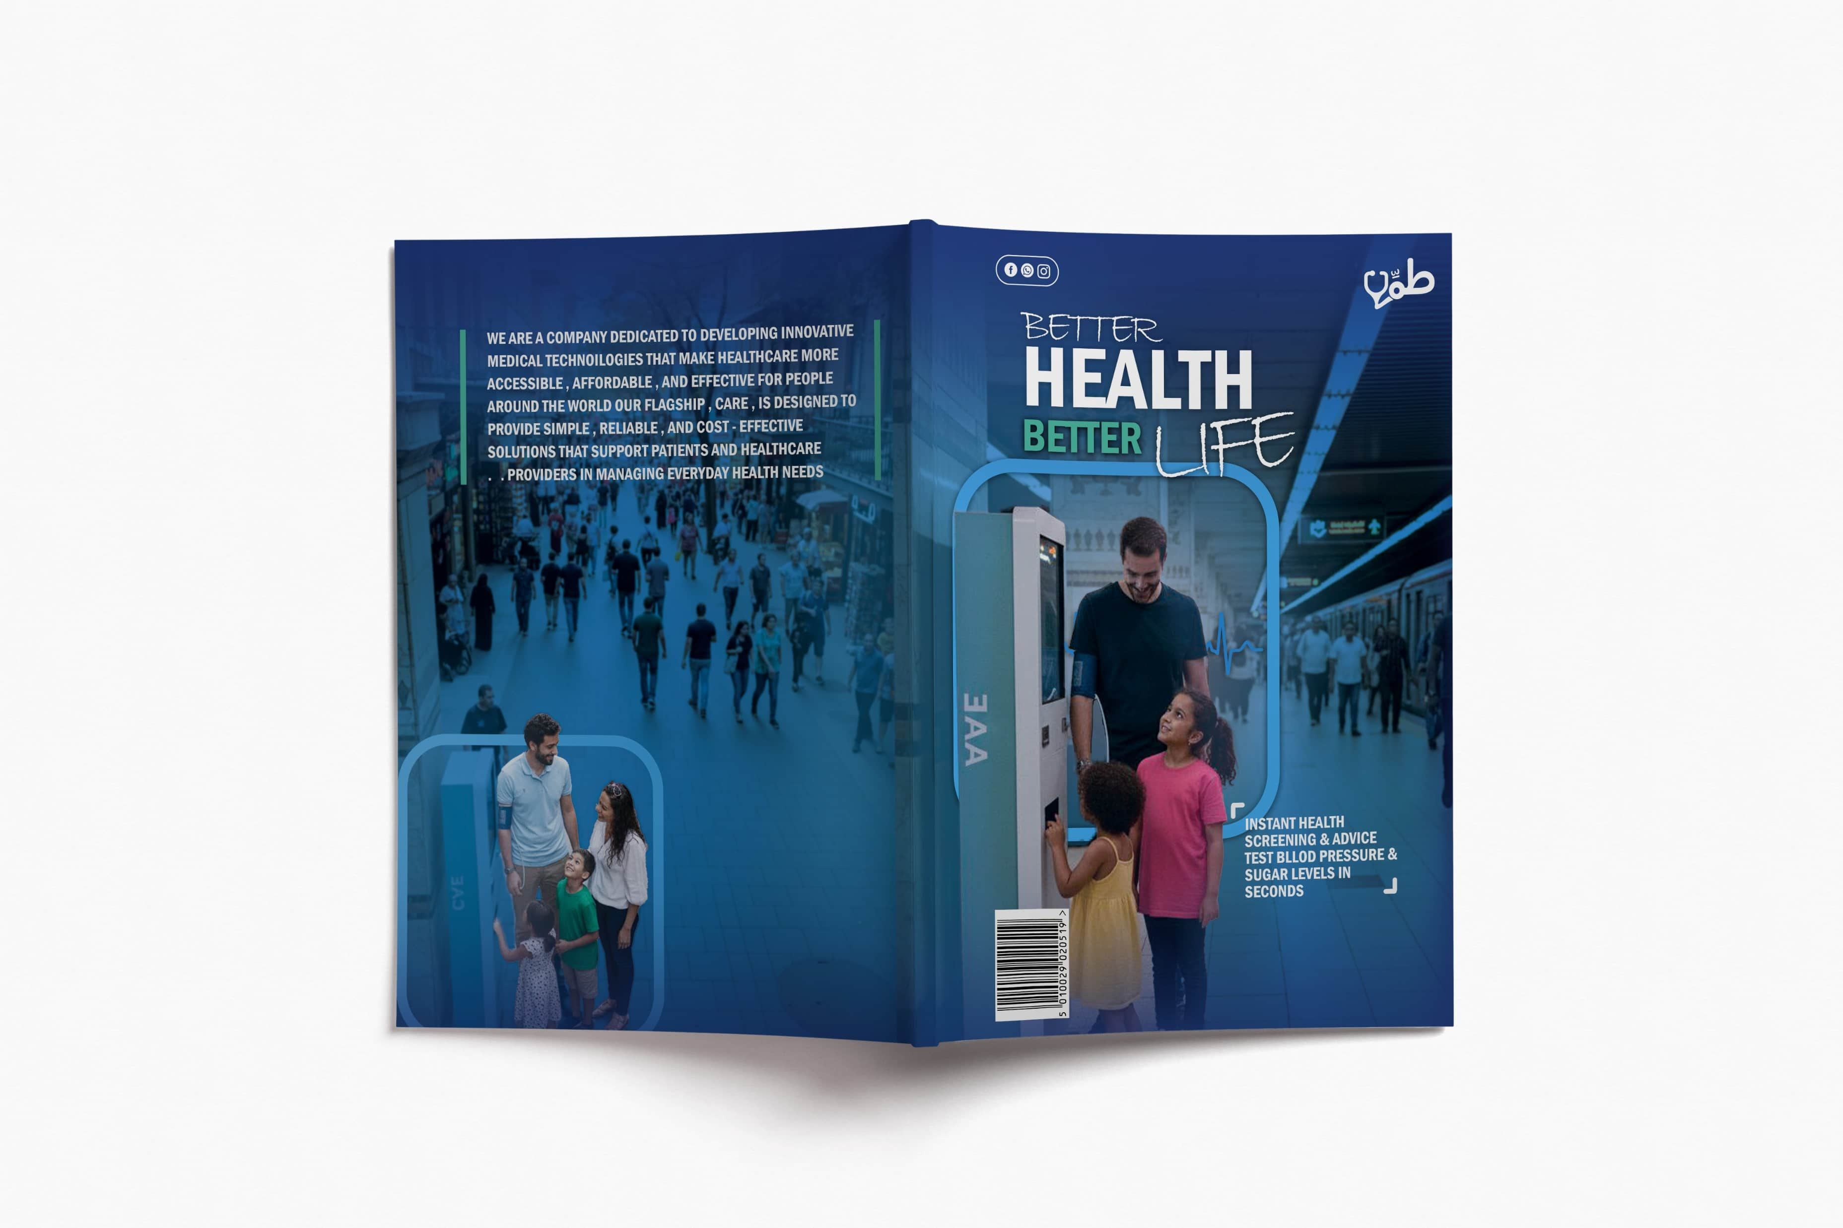
MARKETING
MAGAZINE
03

Slide 38
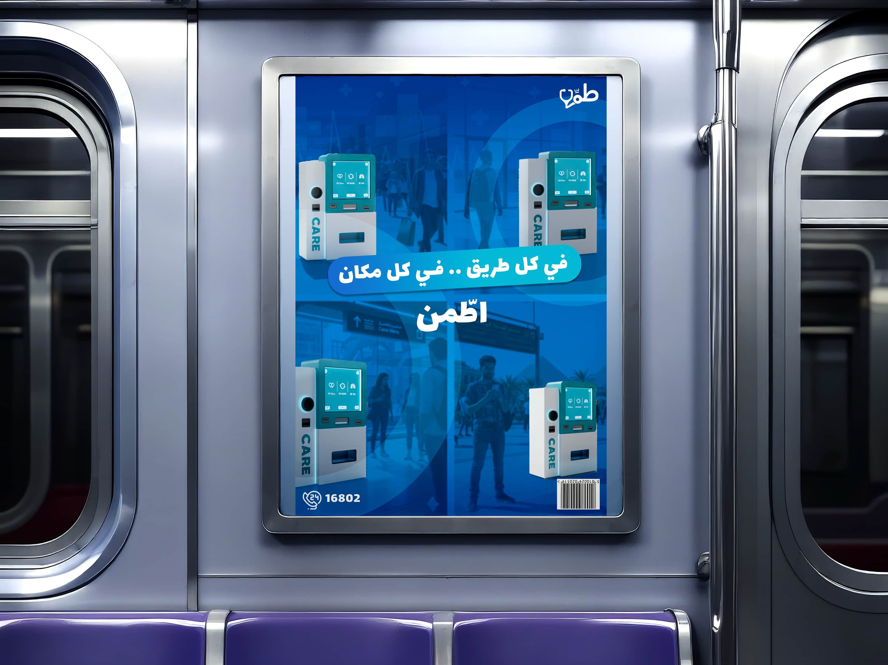
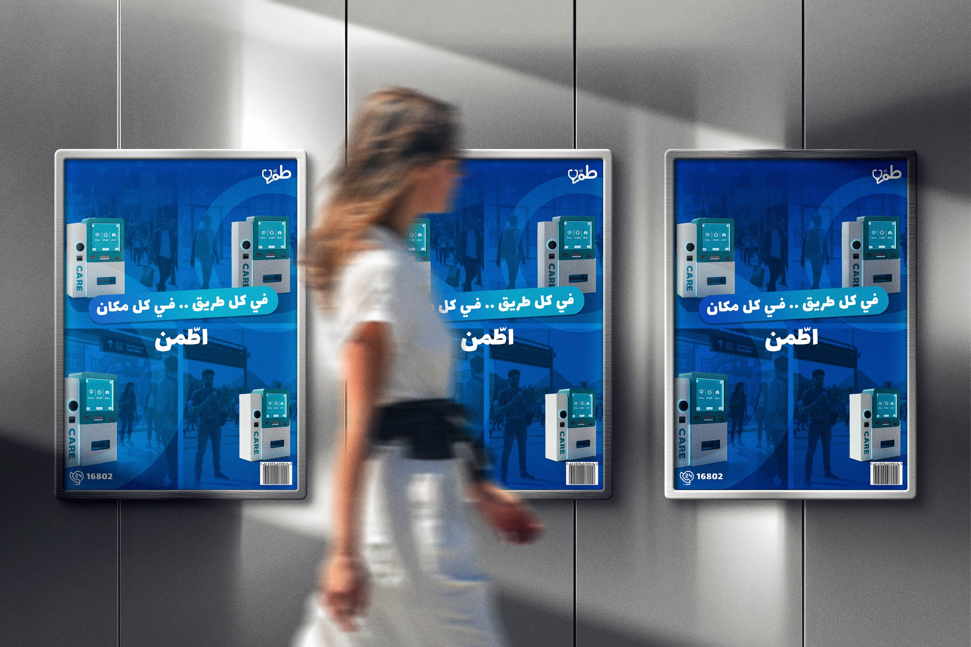
MARKETING
POSTER
04

Slide 39
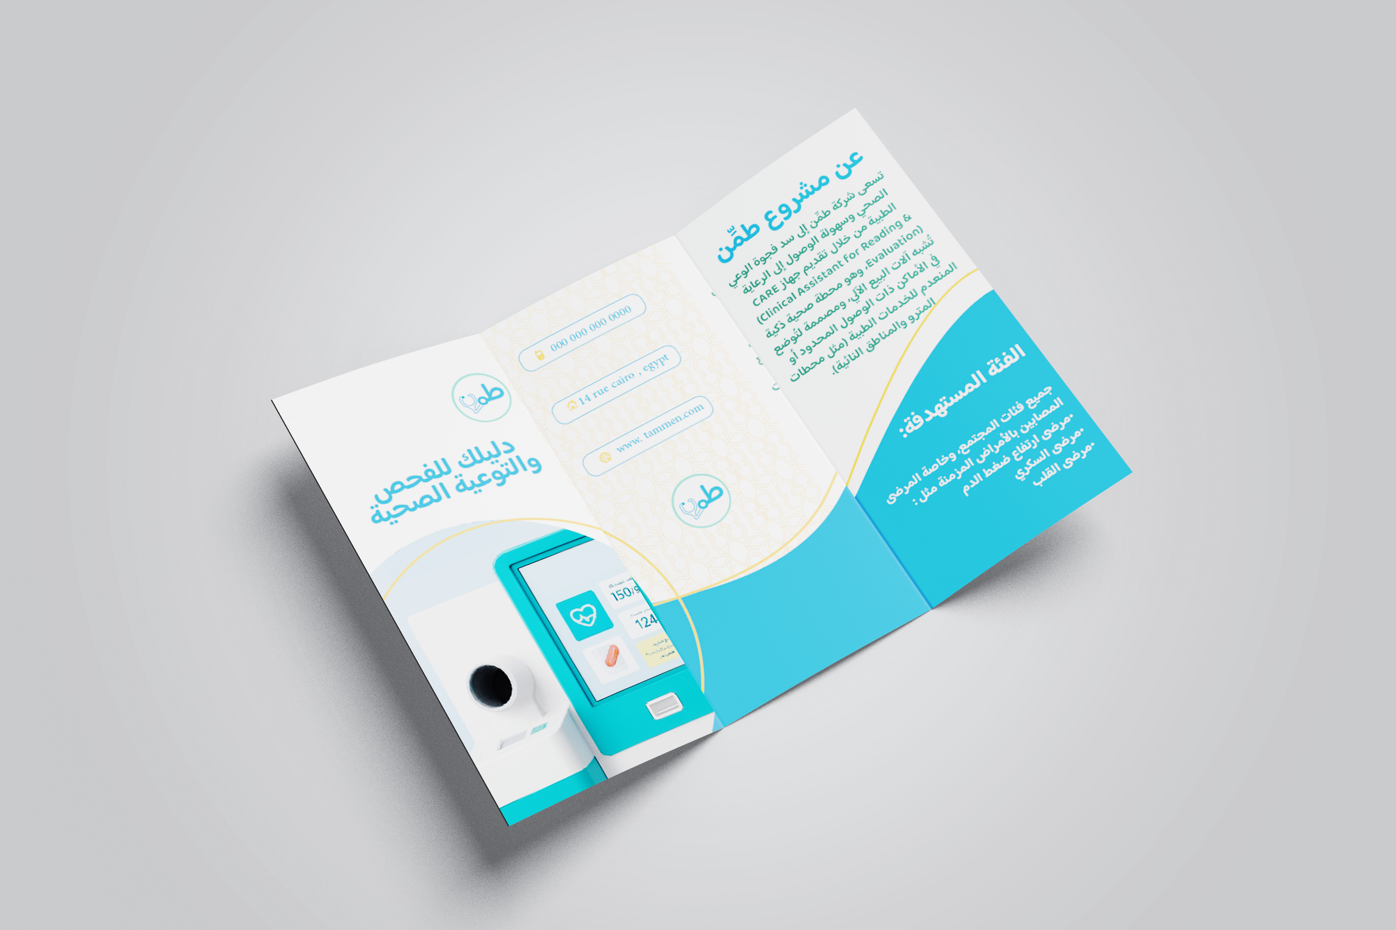
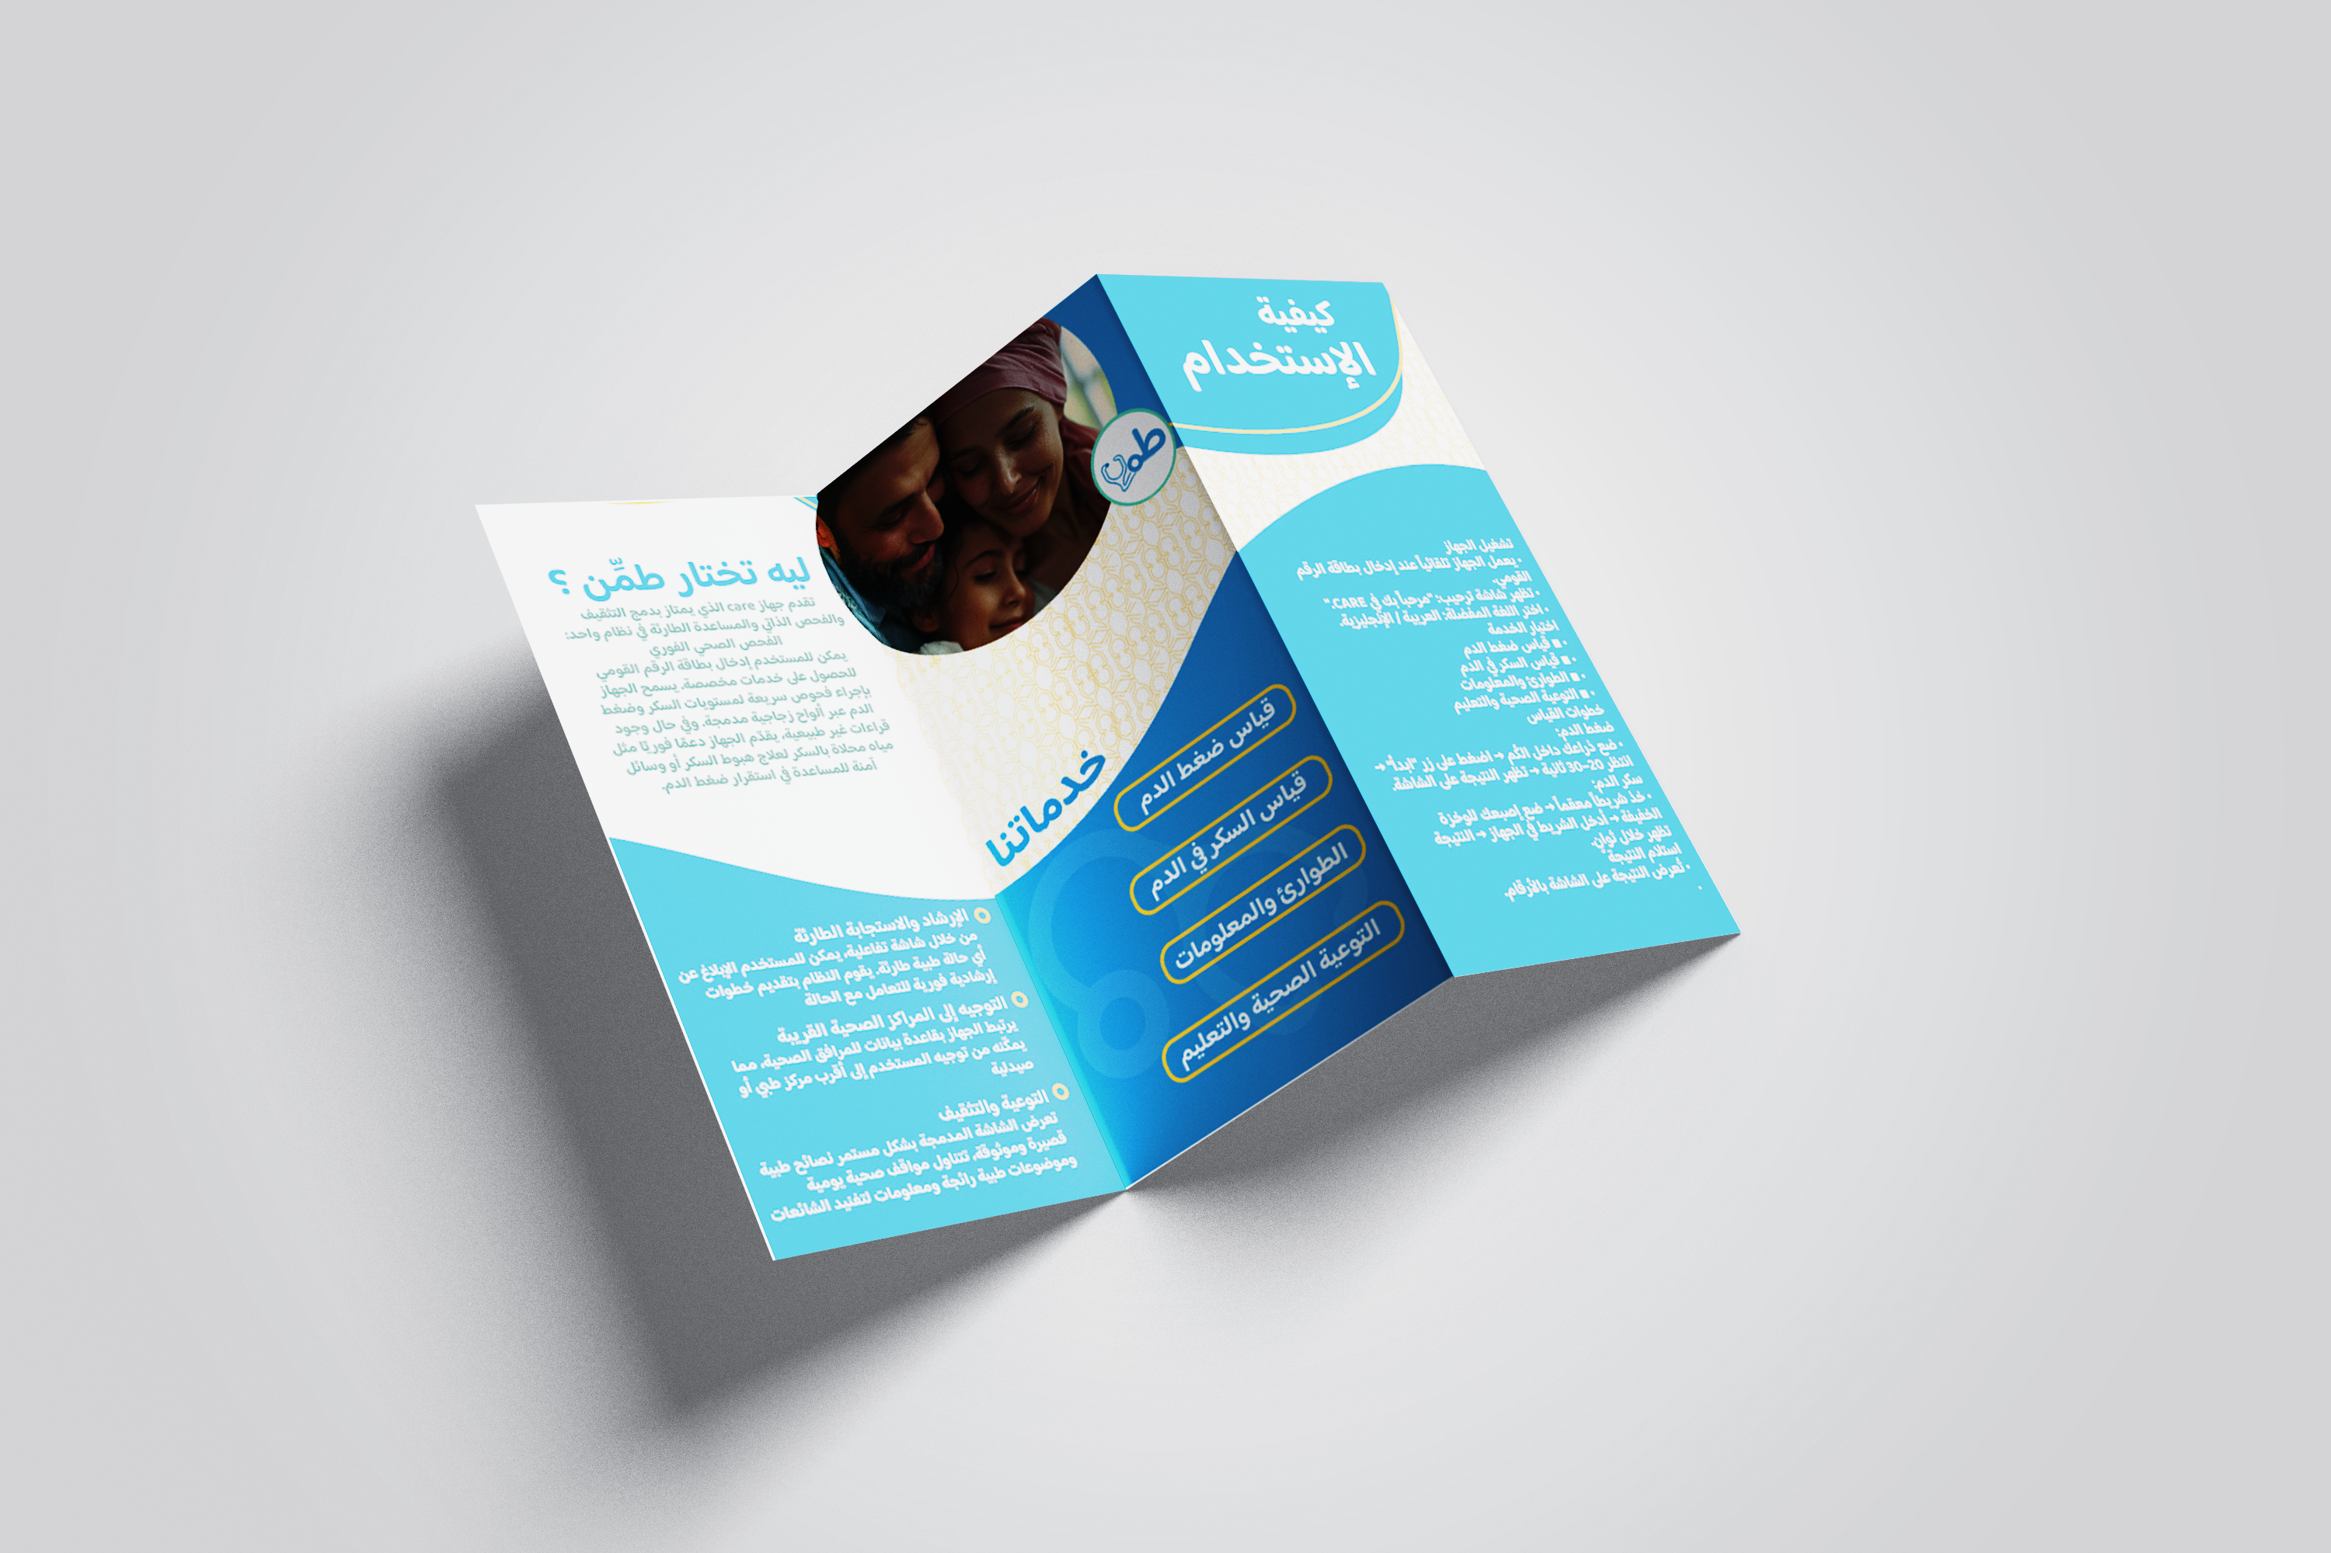
BROCHURE
MARKETING
05

Slide 40

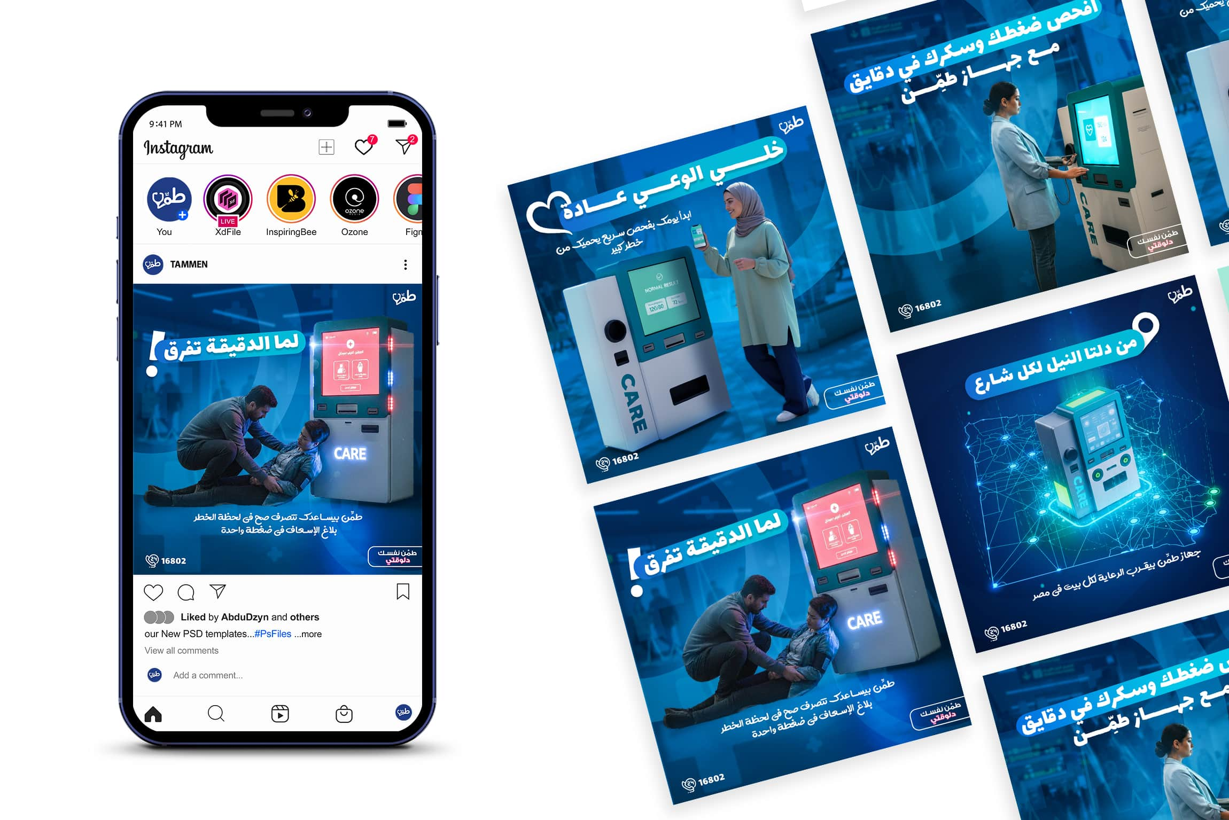
SOCIAL MEDIA ADS
MARKETING
06

Slide 41

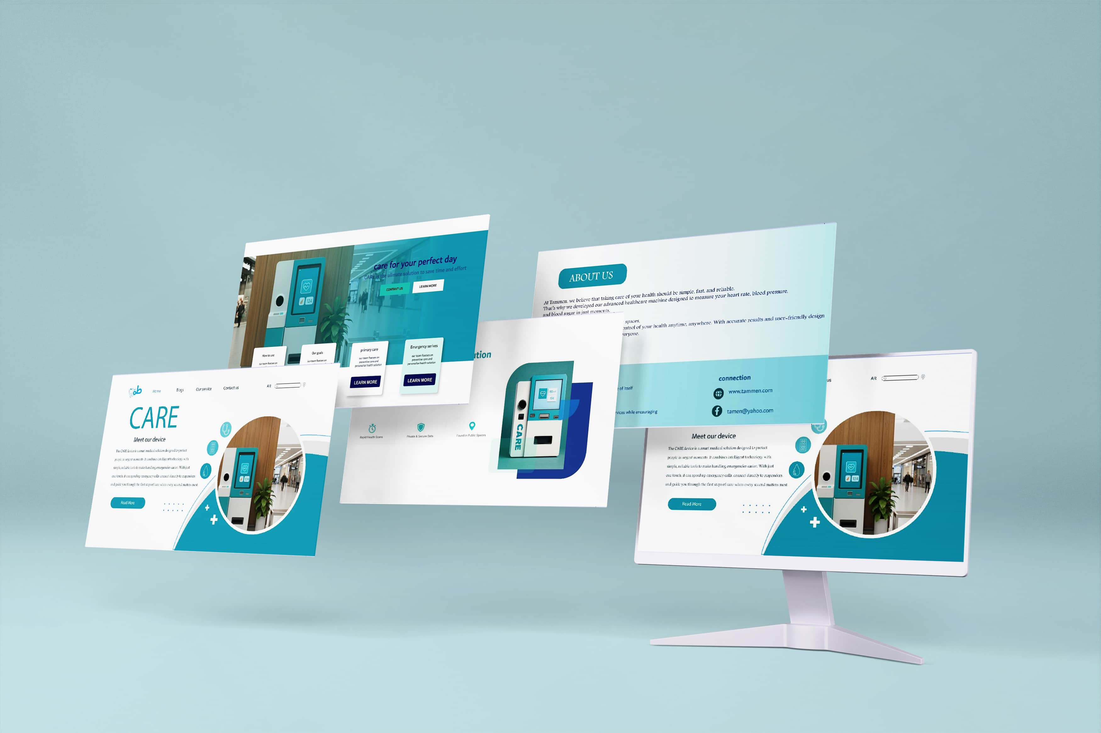
WEBSITE
MARKETING
07

Slide 42
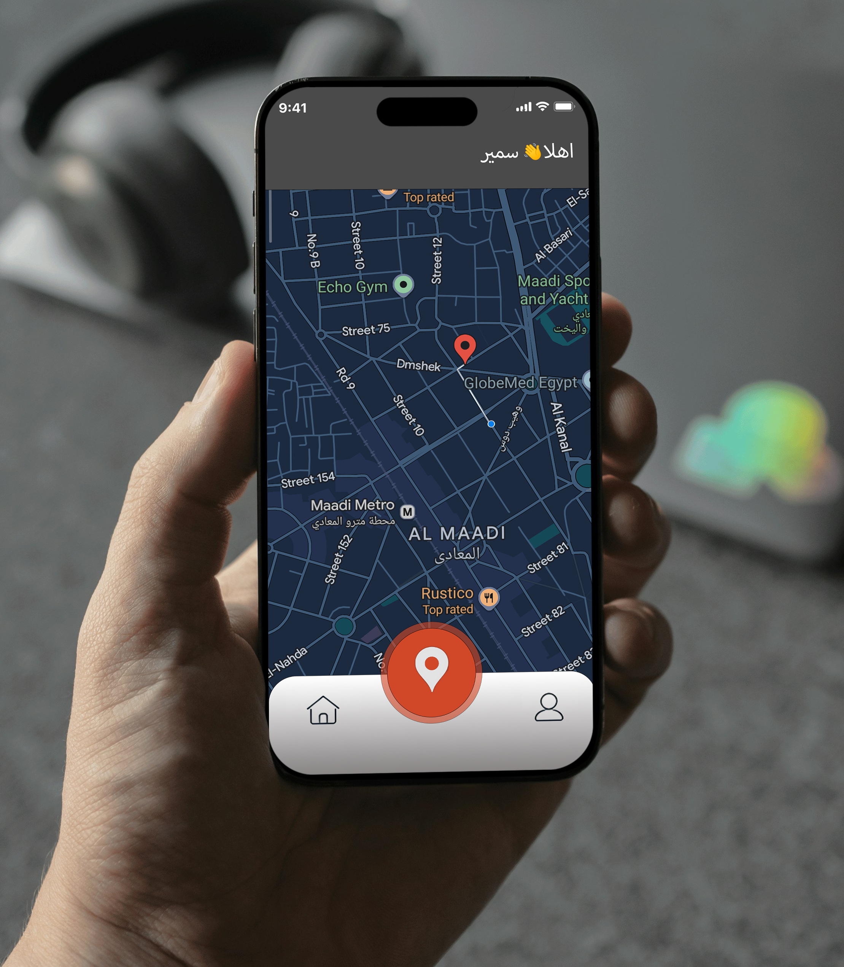
Phone App
MARKETING
08

Slide 43
Magazine
MARKETING
09

Slide 44
COMMON Q&A
1. What does the machine measure?
The machine measures blood pressure and blood sugar levels using accurate, medically aligned sensors. 2. How does the machine help after taking my measurements?
It provides automatic nutritional responses, such as salty water, sugary water, or natural juice, depending on your results.
3. How long does a full check-up take?
A complete reading and response typically takes under 2 minutes.
4. Do I need medical knowledge to use the machine?
Not at all. The interface guides users step-by-step, requiring no prior experience.
5. Where can this machine be installed?
Ideal locations include malls, gyms, pharmacies, workplaces, hospitals, universities, and community centers.

Slide 45
COMMON Q&A
6. How accurate are the readings?
Readings are highly accurate and follow industry-standard medical guidelines for basic health assessments.
7. Does the machine replace a doctor?
No. The machine provides quick check-ups and guidance, but it is not a substitute for professional medical evaluation.
8. Is the machine accessible for Children elderly individuals?
Absolutely. The UI uses large icons, clear instructions, and simple navigation to ensure ease of use.
9. How is hygiene maintained?
All user-contact areas are designed with easy-to-clean materials, and optional automatic sanitizing features can be included.
10. Does the machine store personal data?
Only if enabled. The machine can operate anonymously or integrate with user accounts depending on the deployment setting.

Slide 46
COMMON Q&A
11. What happens if my results are abnormal? The machine shows a warning message and recommends seeking medical advice or repeating the test. With a button to call help so they can provide medical assistance to the patient 12. What power source does it use?
It runs on standard electrical power, with an option for battery backup if required.
13. Can businesses customize the machine?
Yes. Branding, interface design, language, and service options can all be tailored to the customer’s needs.
14. Can the machine operate in high-traffic public areas?
Yes. It is designed for durability and consistent performance, making it suitable for malls, universities, gyms, and other busy locations.
15. Can the results be displayed in multiple languages?
Yes. The user interface supports multilingual options, allowing the machine to serve diverse communities effectively.
16. How does the machine ensure the accuracy of its readings?
It uses high-quality sensors and performs routine internal calibration checks to maintain reliable measurement performance.

